Slide 1
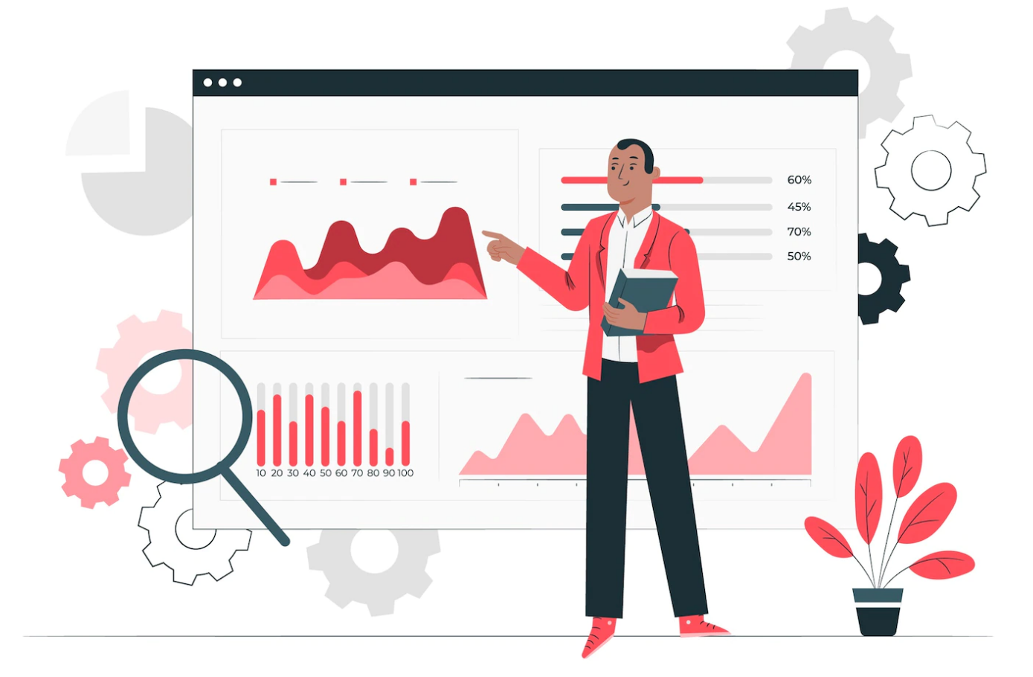
Unlocking values of Data Analytics
Harshil Gandhi
Data(Risk) Analyst – Citi Bank

Slide 2
Agenda for the session
Lesson 1.
What is Data Science/ Data Analytics?
Why it’s Important?
1
Lesson 2.
Applications of Data Science/Analytics.
Relevant or just boom?
2
Lesson 3.
Data Analytics Relevance and importance for LAW Student/practitioner/Researcher
3
Lesson 4.
Understanding the Technology stack
4
Lesson 5.
Hands on..!
5

Slide 3

Course PROGRESS
Lesson 2. Applications of Data Science
Lesson 4. Understanding the Technology Stack
Lesson 5. Hands on..!
Lesson 1. Data Science/Data Analytics
Lesson 3. Data Science for LAW

Slide 4
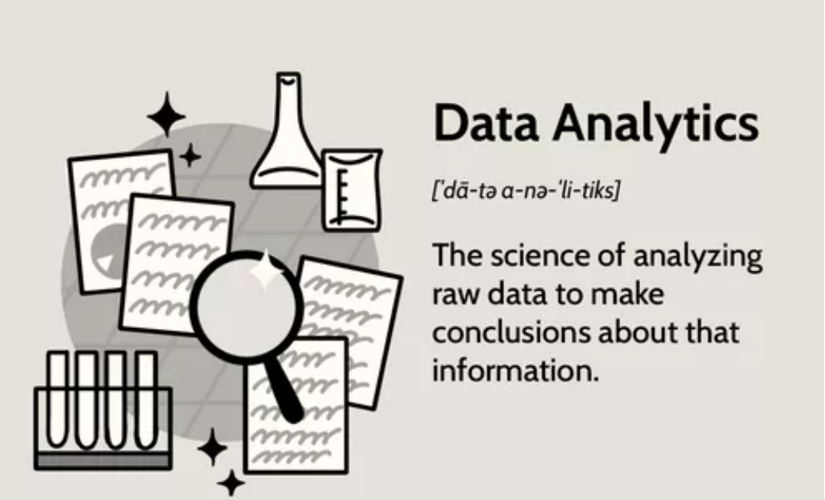
What is Data Analytics?
Data analytics is the science of analyzing raw data to make conclusions about that information.
Data analytics help a business optimize its performance, perform more efficiently, maximize profit, or make more strategically-guided decisions.
The techniques and processes of data analytics have been automated into mechanical processes and algorithms that work over raw data for human consumption.
Data analytics relies on a variety of software tools ranging from spreadsheets, data visualization, and reporting tools, data mining programs, or open-source languages for the greatest data manipulation.

Slide 5
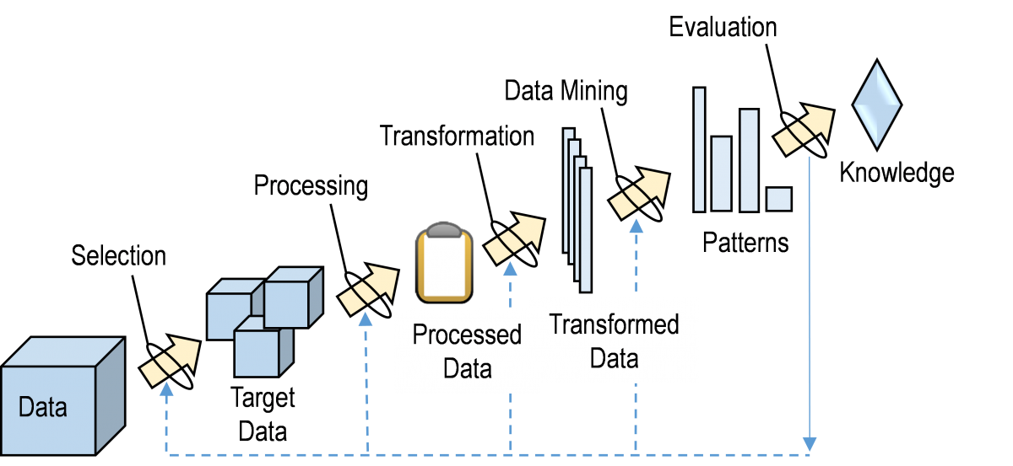
Journey from Data to Information

Slide 6
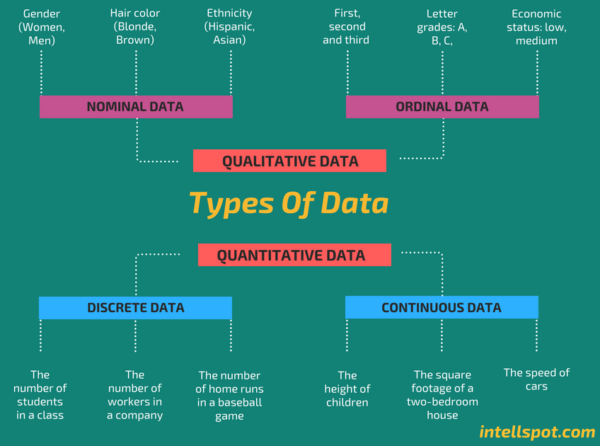
Types of Data !

Slide 7
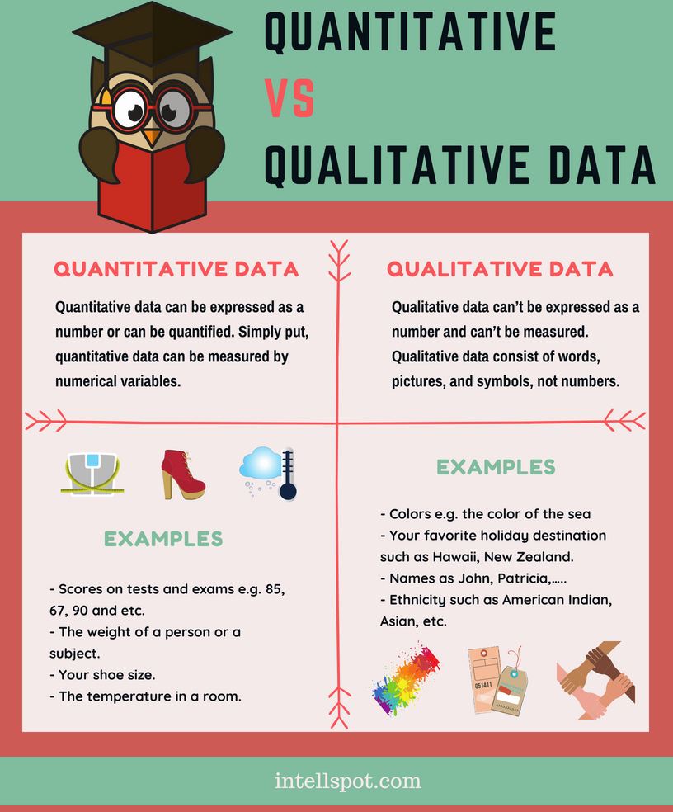
Types of Data !
Types of data
1)Quantitative Data
2) Qualitative Data

Slide 8
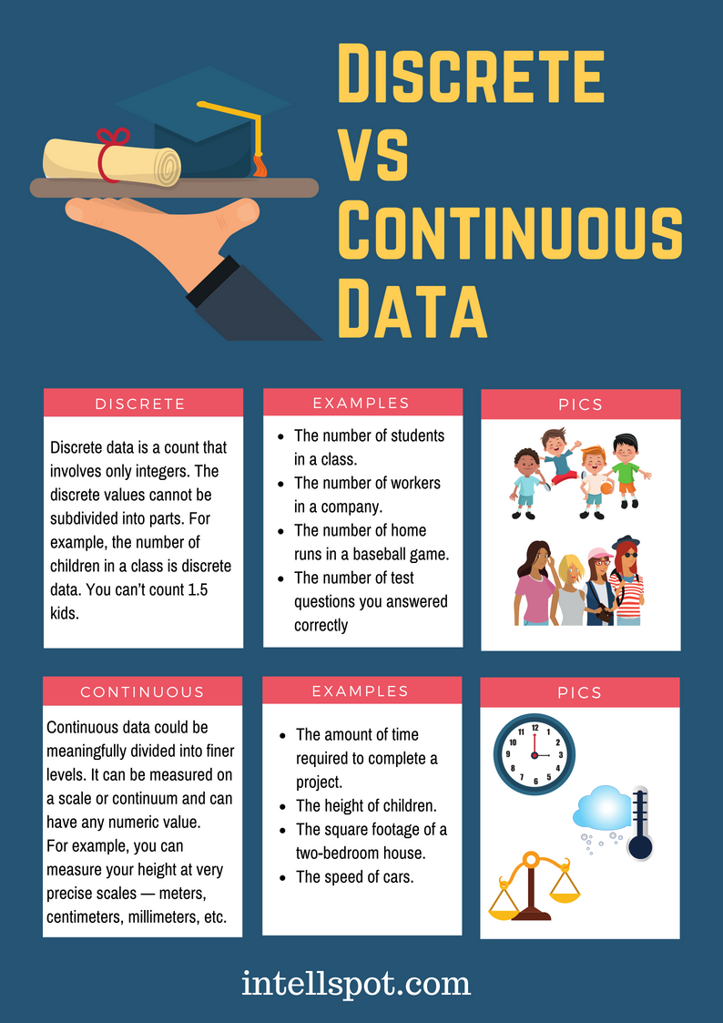
Types of Data !
Quantitative Data ->

Slide 9
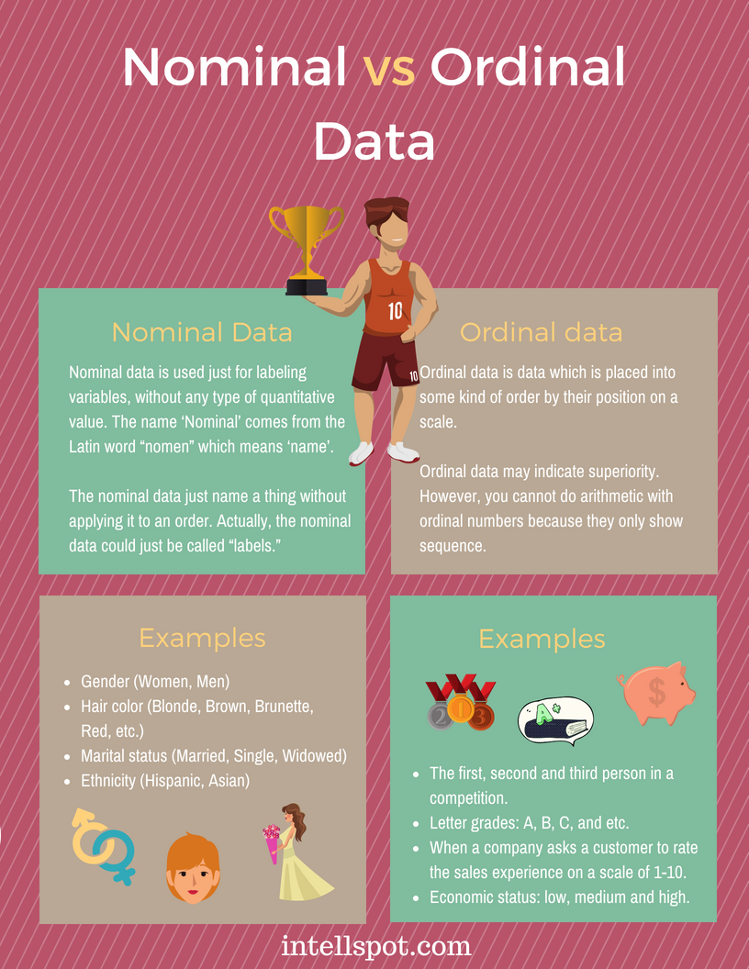
Types of Data !
Qualitative Data ->

Slide 10
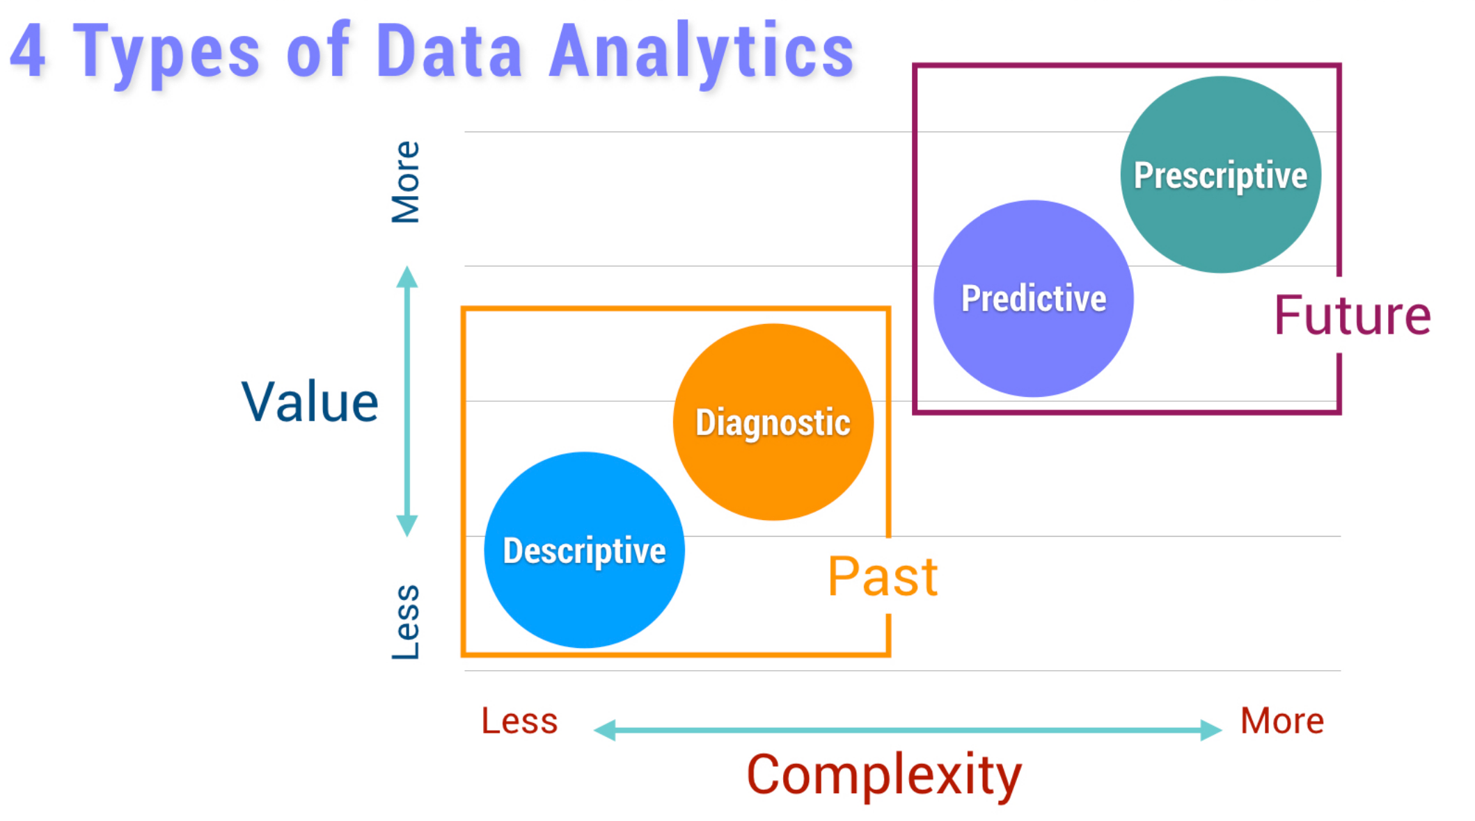
Types of data Analytics

Slide 11
Descriptive and Diagnostic Analytics -> PAST
Descriptive Analytics:
Descriptive analytics looks at data and analyze past event for insight as to how to approach future events.
It looks at the past performance and understands the performance by mining historical data to understand the cause of success or failure in the past. Almost all management reporting such as sales, marketing, operations, and finance uses this type of analysis.
The descriptive model quantifies relationships in data in a way that is often used to classify customers or prospects into groups. Unlike a predictive model that focuses on predicting the behavior of a single customer, Descriptive analytics identifies many different relationships between customer and product.
Diagnostic Analytics:
In this analysis, we generally use historical data over other data to answer any question or for the solution of any problem. We try to find any dependency and pattern in the historical data of the particular problem.
This focuses more on why something happened. This involves more diverse data inputs and a bit of hypothesizing. Did the weather affect beer sales? Did that latest marketing campaign impact sales?

Slide 12
Predictive and Perspective Analytics -> Future
Predictive Analytics
Predictive analytics turn the data into valuable, actionable information. predictive analytics uses data to determine the probable outcome of an event or a likelihood of a situation occurring.
Predictive analytics holds a variety of statistical techniques from modeling, machine, learning, data mining, and game theory that analyze current and historical facts to make predictions about a future event.
Prescriptive Analytics:
Prescriptive analytics goes beyond predicting future outcomes by also suggesting action benefit from the predictions and showing the decision maker the implication of each decision option.
Further, Prescriptive Analytics can suggest decision options on how to take advantage of a future opportunity or mitigate a future risk and illustrate the implication of each decision option
This suggests a course of action. If the likelihood of a hot summer is measured as an average of these five weather models is above 58%, we should add an evening shift to the brewery and rent an additional tank to increase output.

Slide 13
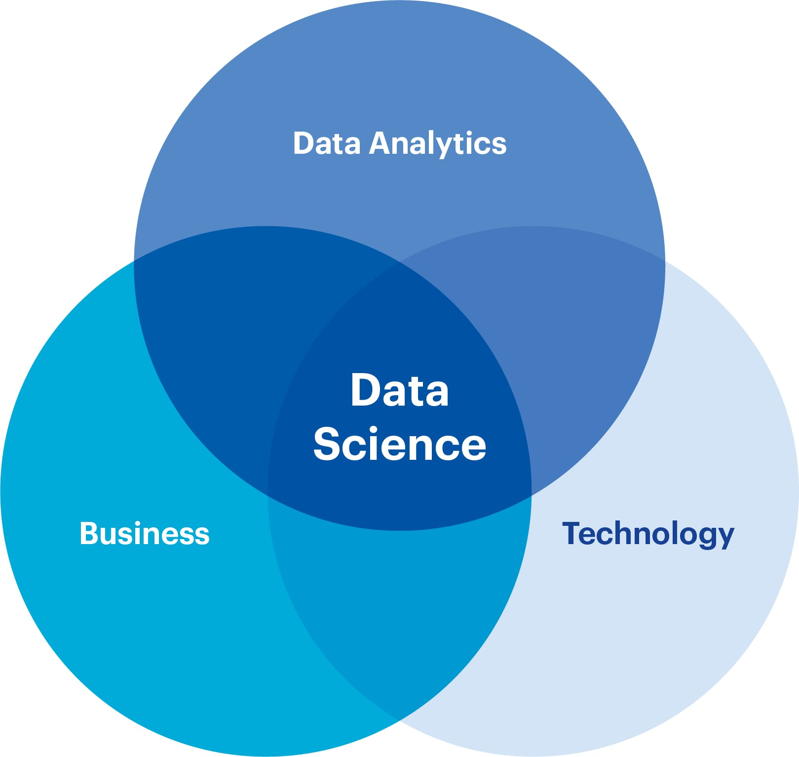
Data Science?
Data Science is the science of dealing with all the data growing in every field, industry, and domain.
Data Science is an interdisciplinary field that deals with collecting, analysing, and interpreting huge volumes of data.
It is the process of extracting the data from structured, unstructured data using the Data mining technique (for getting the information from raw data).
Pillars of Data Science
Statistics / Analysis / Mathematics / Algorithms
Technology
Domain / Business

Slide 14
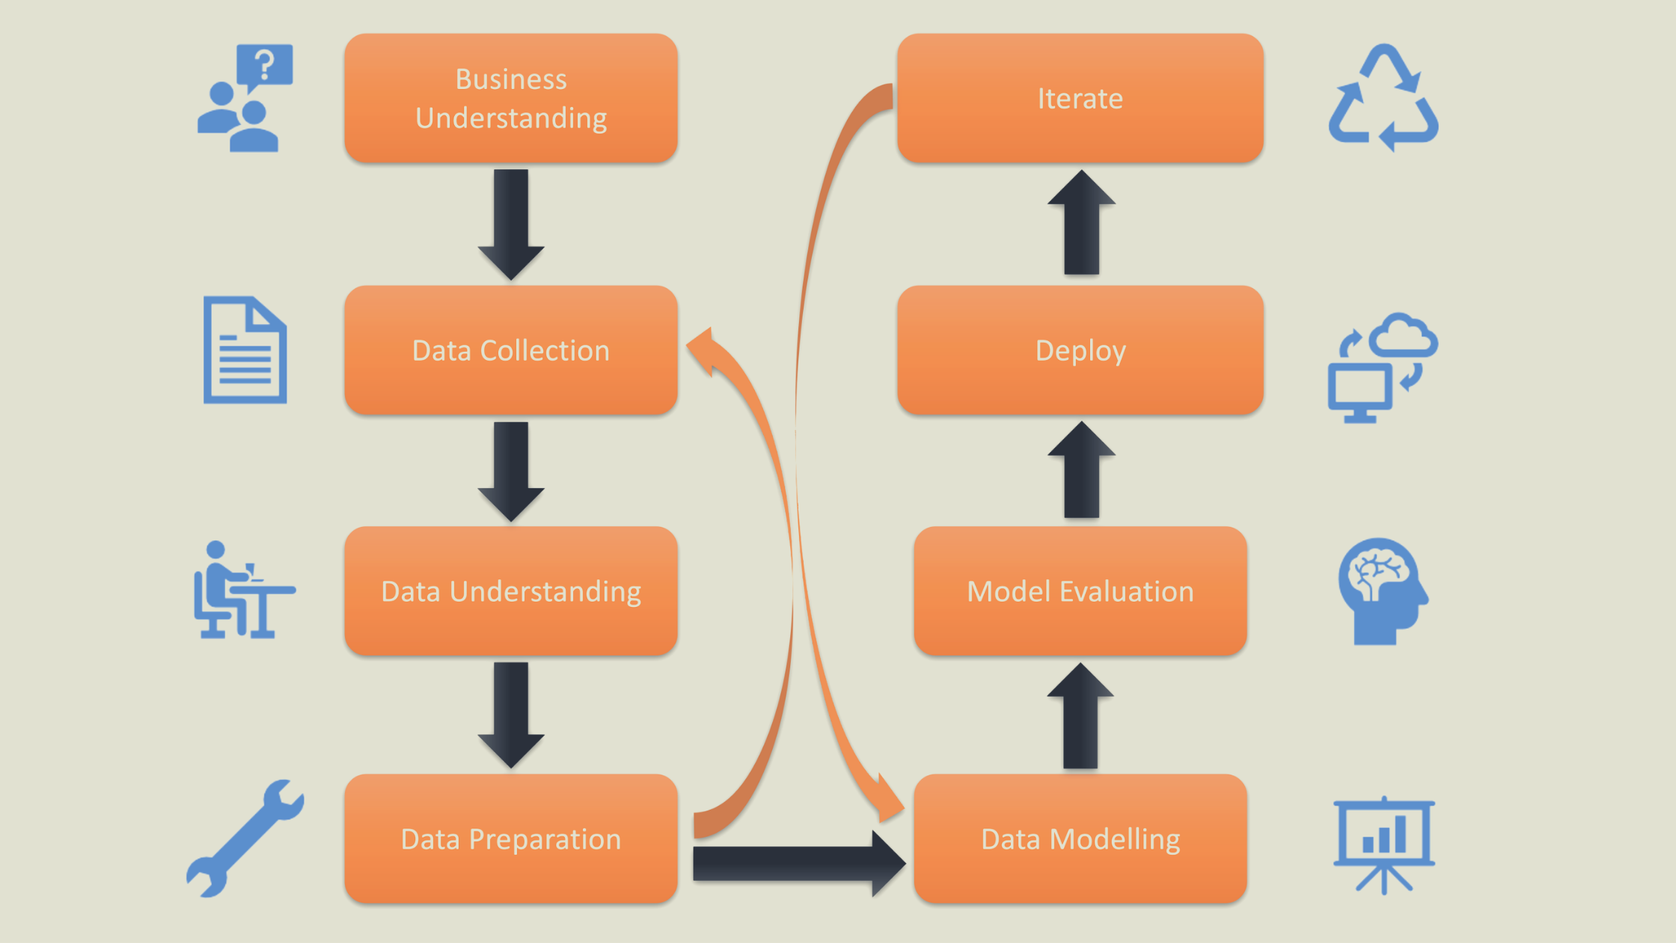
Life Cycle of a Typical Data Science Project

Slide 15
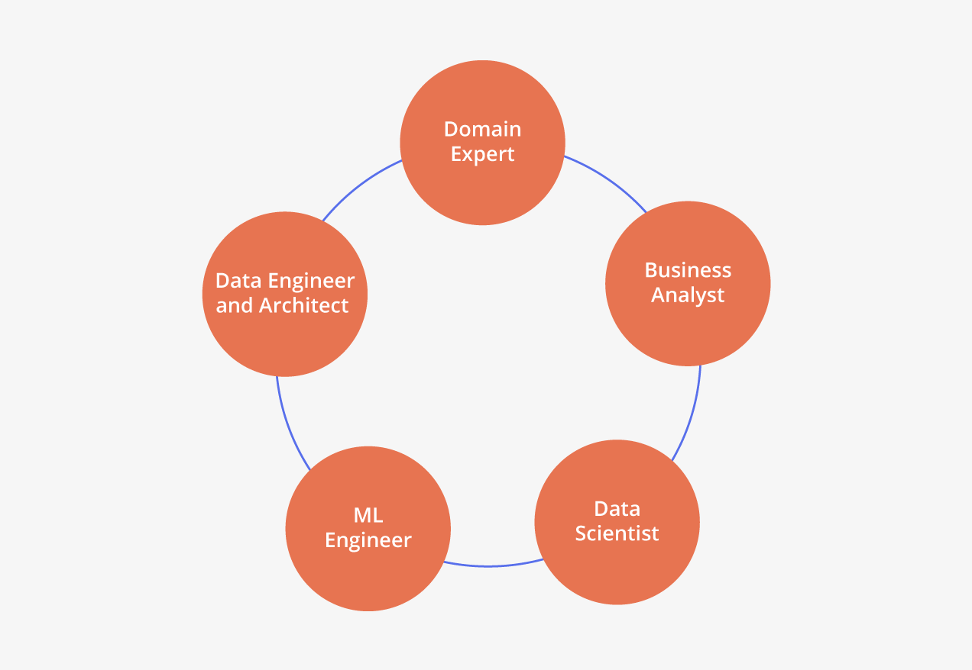
Roles in a Typical Data Science Project
Domain Expert: The data science projects are applied in different domains or industries of real life like Banking, Healthcare, Petroleum industry etc. A domain expert is a person who has experience of working in the particular domain and knows in and out about the domain.
Business analyst: A business analyst is required to understand the business needs in the domain identified. The person can guide in devising the right solution and timeline for the same.
Data Scientist: A data scientist is the expert in data science projects and has experience of working with data and can workout the solution as what data is needed to produce the required solution.
Machine Learning Engineer: A machine learning engineer can advise on which model to be applied to get the desired output and devise a solution to produce the correct and required output.
Data Engineer and Architect: Data Architect and Data engineer are the experts in modelling of data. Visualization of data for better understanding as well as storage and efficient retrieval of data are looked after by them.

Slide 16
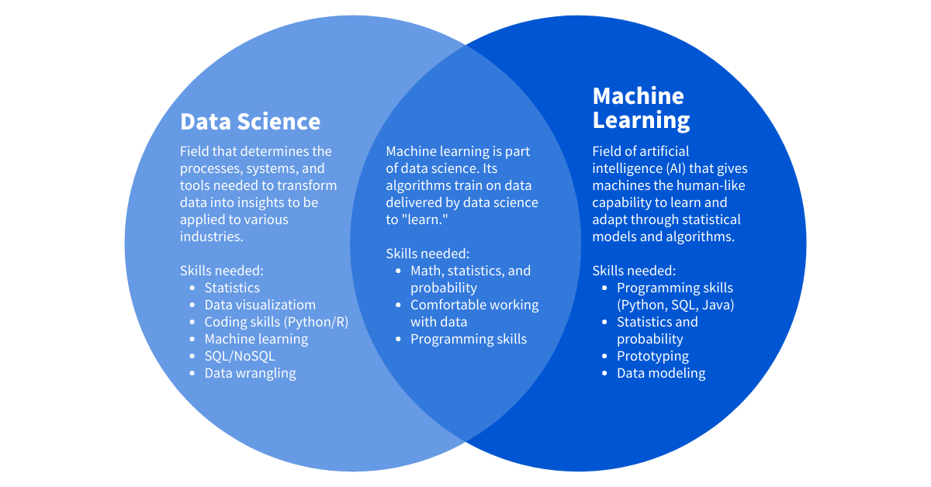
Machine Learning
Data science is a field that studies data and how to extract meaning from it
whereas machine learning is a field devoted to understanding and building methods that utilize data to improve performance or inform predictions.
Machine learning is a branch of artificial intelligence.

Slide 17
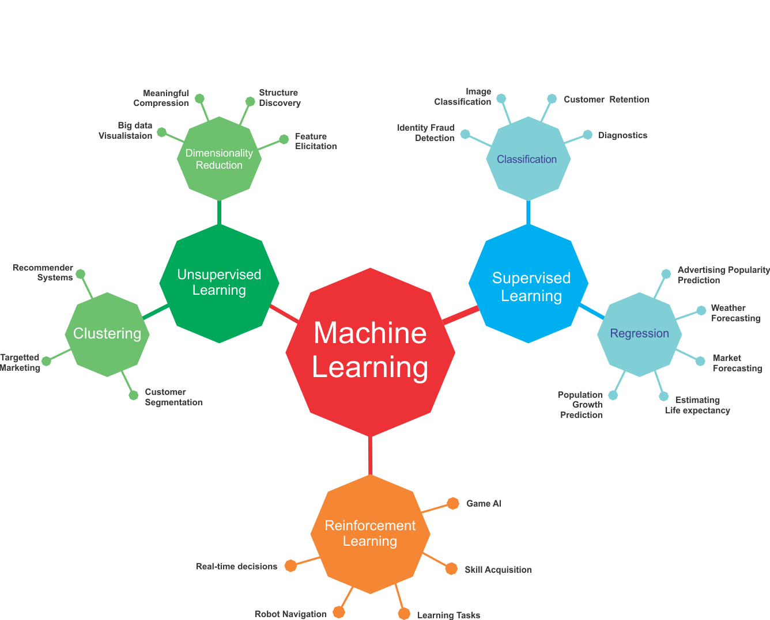
Machine Learning

Slide 18
Types of Learning
1. Supervised Learning:
How it works: This algorithm consists of a target/outcome variable (or dependent variable) which is to be predicted from a given set of predictors (independent variables). Using this set of variables, we generate a function that map inputs to desired outputs. The training process continues until the model achieves a desired level of accuracy on the training data. Examples of Supervised Learning: Regression, Decision Tree, Random Forest, KNN, Logistic Regression etc.
2. Unsupervised Learning:
How it works: In this algorithm, we do not have any target or outcome variable to predict / estimate. It is used for clustering populations in different groups, which is widely used for segmenting customers into different groups for specific interventions. Examples of Unsupervised Learning: Apriori algorithm, K-means.
3. Reinforcement Learning:
How it works: Using this algorithm, the machine is trained to make specific decisions. It works this way: the machine is exposed to an environment where it trains itself continually using trial and error. This machine learns from past experience and tries to capture the best possible knowledge to make accurate business decisions.
Example of Reinforcement Learning: Markov Decision Process

Slide 19
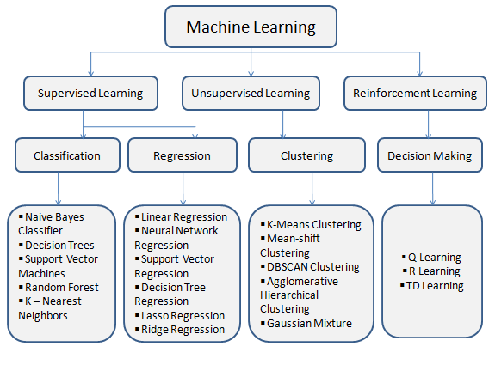
Major Algorithms
Along with that below are also important areas of Data Science..!
Time series Analysis/Forecasting
Natural Language Processing (NLP)
AI Algorithms
Deep Learning
Computer Vision

Slide 20
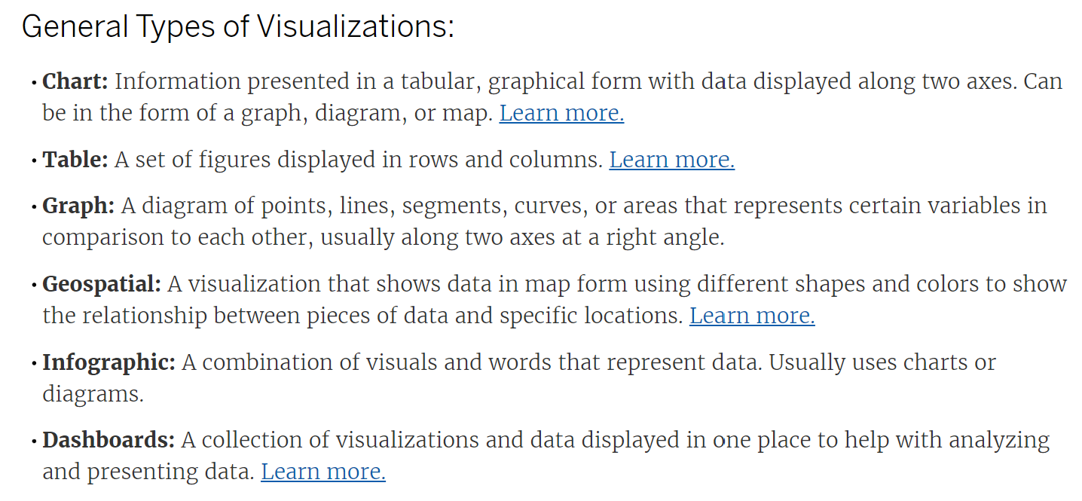
Data Visualization
Data visualization is the graphical representation of information and data.
By using visual elements like charts, graphs, and maps, data visualization tools provide an accessible way to see and understand trends, outliers, and patterns in data.
Additionally, it provides an excellent way for employees or business owners to present data to non-technical audiences without confusion.
In the world of Big Data, data visualization tools and technologies are essential to analyze massive amounts of information and make data-driven decisions.

Slide 21
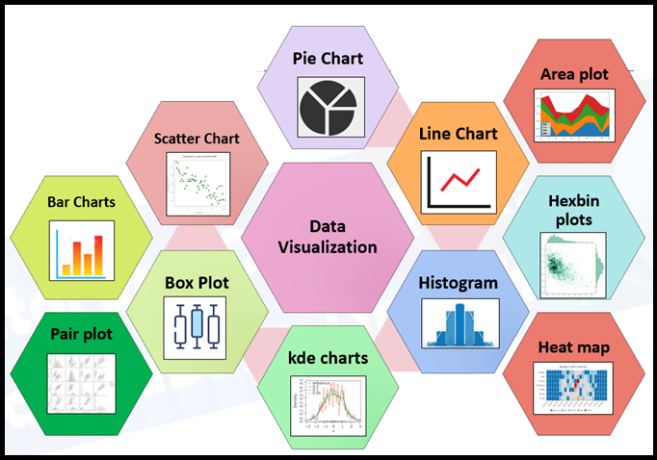
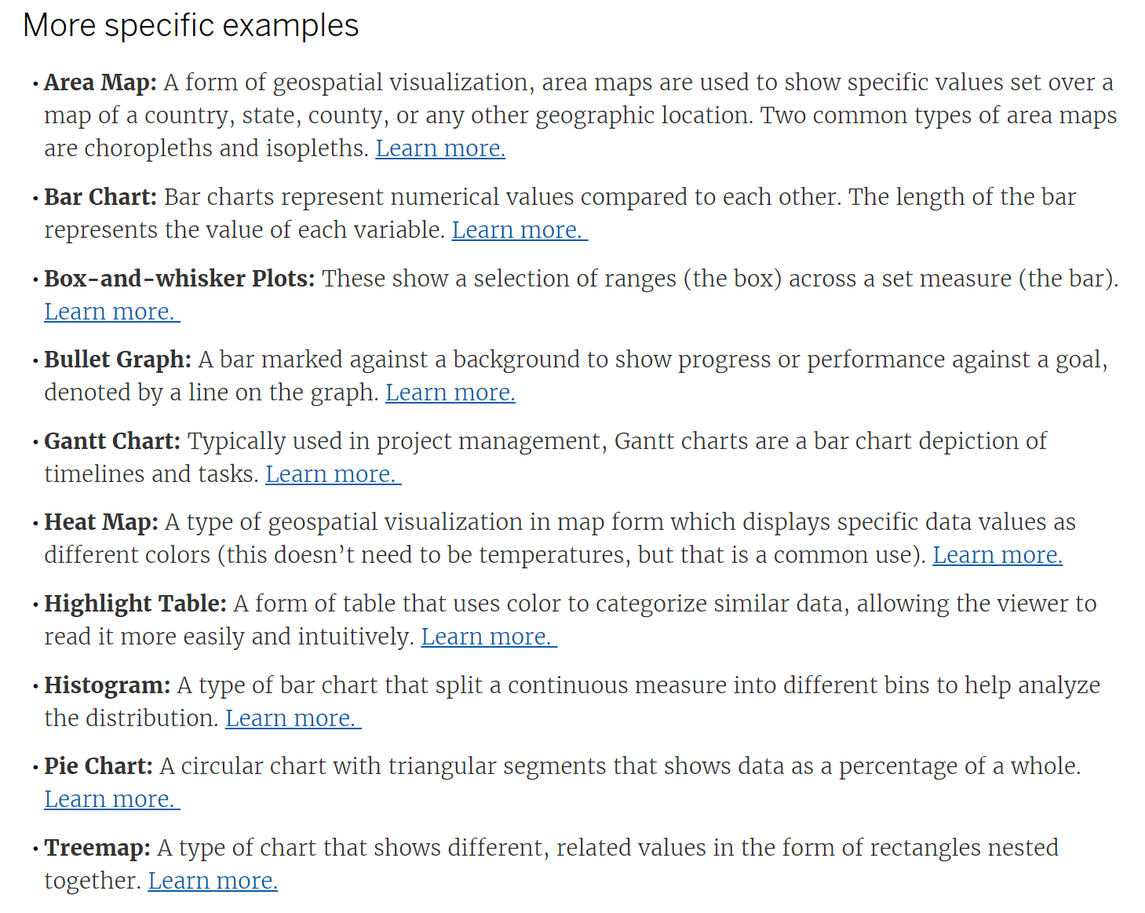
Data Visualization

Slide 22
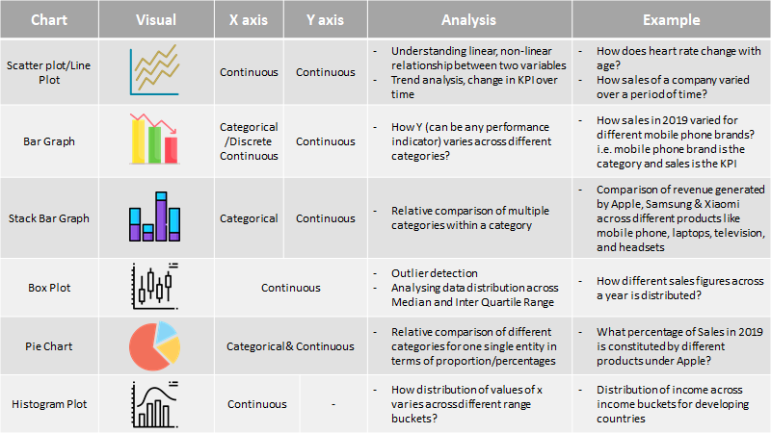
Best Suited Chart based on data Availability

Slide 23
Course PROGRESS
Lesson 2. Applications of Data Science
Lesson 4. Understanding the Technology Stack
Lesson 5. Hands on..!
Lesson 1. Data Science/Data Analytics
Lesson 3. Data Science for LAW

Slide 24
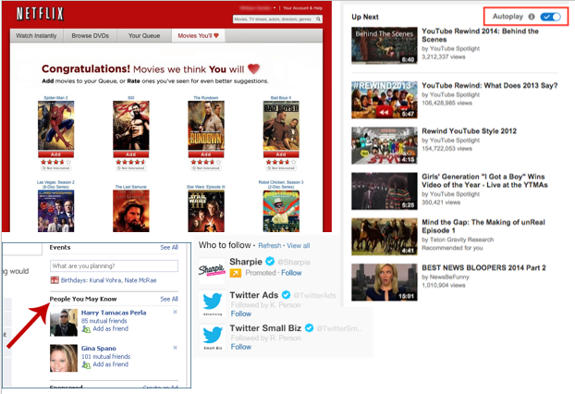
Recommender System
Netflix and Amazon give movie and product recommendations based on what you like to watch, purchase, or browse on their platforms.
Internet giants like Twitter, Google Play, Linkedin, imdb, and many more uses this system to improve user experience.
The recommendations are made based on previous search results for a user.

Slide 25
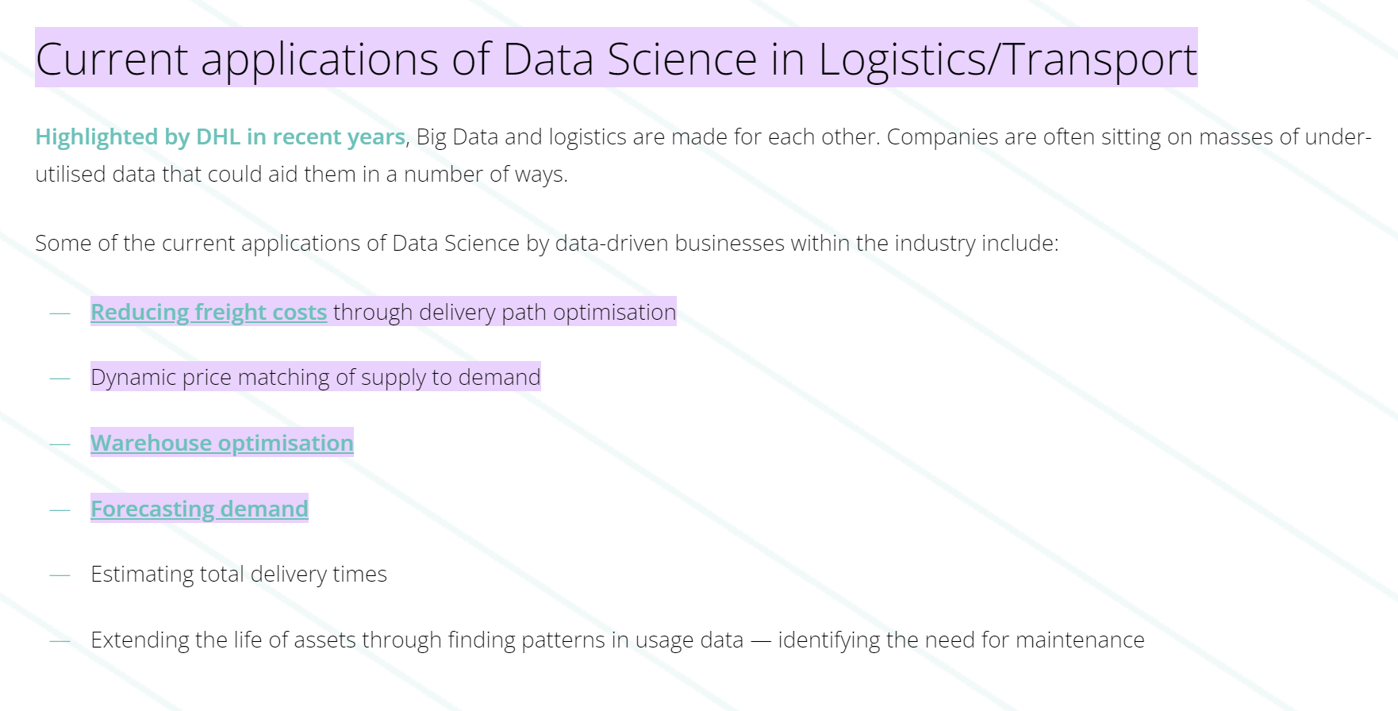
Logistics
Data Science is used by logistics companies to optimize routes to ensure faster delivery of products and increase operational efficiency.
Case Study:
https://www.cambridgespark.com/case-studies/perpetuum-case-study#:~:text=Current%20applications%20of%20Data%20Science%20in%20Logistics%2FTransport&text=Reducing%20freight%20costs%20through%20delivery,Forecasting%20demand

Slide 26
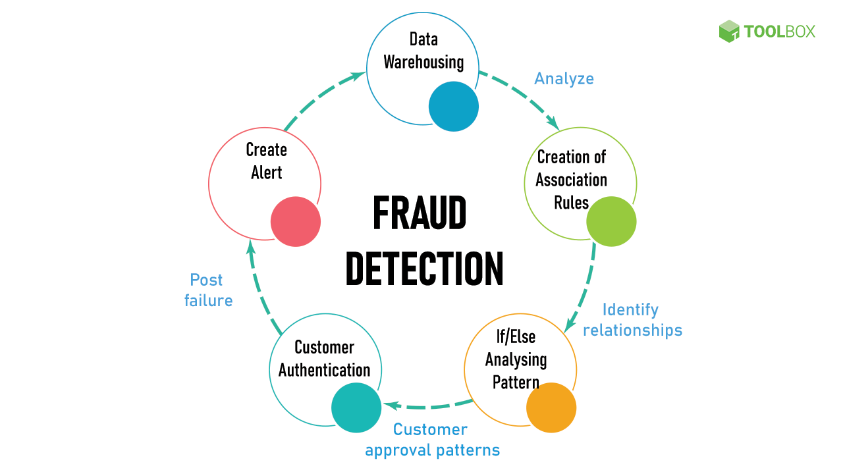
Fraud Detection -> Majorly in Banking
The main AI techniques used for fraud detection include: Data mining to classify, cluster, and segment the data and automatically find associations and rules in the data that may signify interesting patterns, including those related to fraud.
Expert systems to encode expertise for detecting fraud in the form of rules.

Slide 27
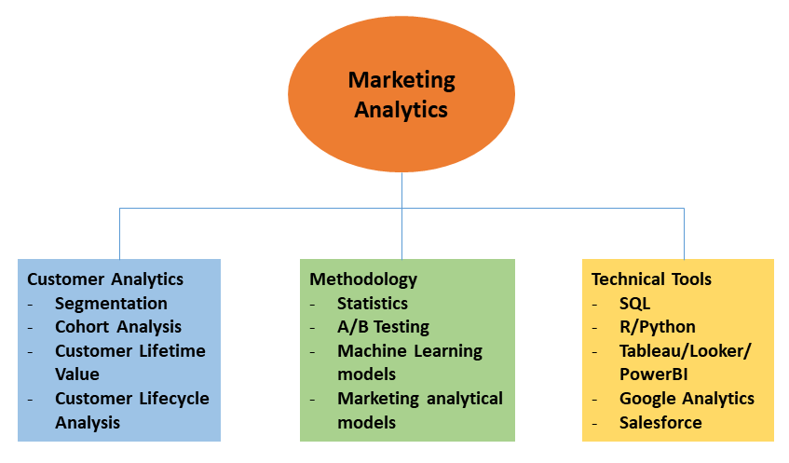
Targeted Advertising – Marketing Analytics
If you thought Search was the most essential data science use, consider this: the whole digital marketing spectrum. From display banners on various websites to digital billboards at airports, data science algorithms are utilised to identify almost anything.
This is why digital advertisements have a far higher CTR (Call-Through Rate) than traditional marketing. They can be customised based on a user's prior behaviour.
That is why you may see adverts for Data Science Training Programs while another person sees an advertisement for clothes in the same region at the same time.

Slide 28
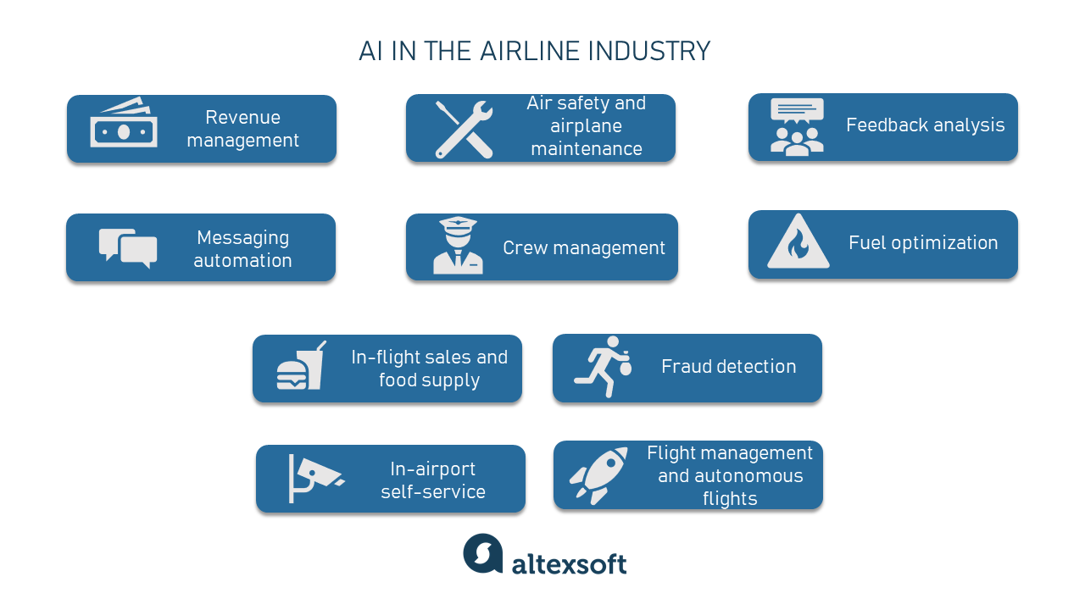
Airline Route Planning / Airline Industry
Understanding traveler demand for specific city pairs and pricing flights are among the main problems airlines solve to survive. To do that carriers must consider thousands of factors when analyzing data. While analysts still can use traditional statistical approaches.
Data science allows for more sophisticated ways to accomplish demand analysis. IATA suggests that airlines can use traveler behavioral data, abandon searches on the online travel agents, and metasearch sites or social media chatter can help define leisure demand.

Slide 29
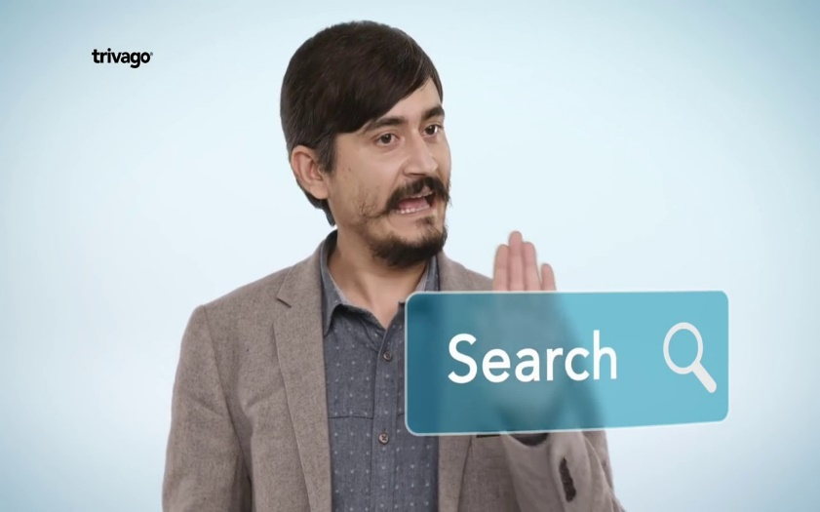






Smart Websites
Price Comparison Website
Vacation/Movie Planning
Food Ordering

Slide 30
Course PROGRESS
Lesson 2. Applications of Data Science
Lesson 4. Understanding the Technology Stack
Lesson 5. Hands on..!
Lesson 1. Data Science/Data Analytics
Lesson 3. Data Science for LAW

Slide 31
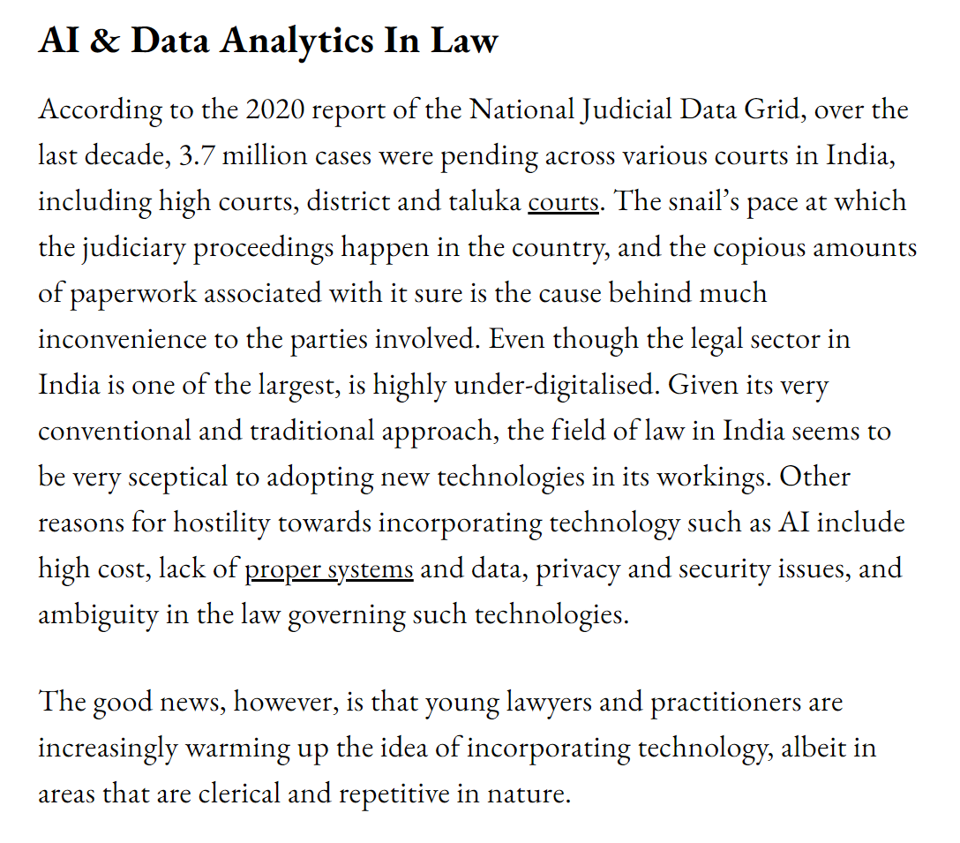
Fact Check
The good news, however, is that young lawyers and practitioners are increasingly warming up the idea of incorporating technology, albeit in areas that are clerical and repetitive in nature.
To help in realising greater output from the available data to gain a better perspective by analysing patterns of the decision of judges in similar cases, law practitioners are now turning to legal analytics. These strategic insights from legal analytics are believed to give law firms a competitive advantage and yield profits by incorporating Machine learning and Natural language processing(NLP).
Artificial intelligence tools can also support law professionals in conducting due diligence in finding and understanding background information by conducting a fact check on the facts and figures. This speeds up the process while also eliminating the possibility of manual inaccuracies.

Slide 32
The future of law in India: Why 94% believe research and analytics is the top skill a lawyer needs
BML Munjal University (BMU) School of Law recently conducted this one-of-its-kind survey to find out what the next generation of law professionals perspective on the evolution of the legal environment in the country. Done in collaboration with Vahura (https://vahura.com/), a legal search and consulting firm, the survey provides aspiring lawyers with all the information they need on the future of legal practice.
Top skills required !
Research and analytics (94%)
Attention to detail and a sharp eye for accuracy (93%)
Ability to work hard (71%)
An openness to learn (72%)
Oral and communication skills (88%)
In a recent survey, it was found that 42 % of law practitioners anticipate that 20 % of their day to day legal work could be taken over by technology such as AI in the next 3 to 5 years.

Slide 33
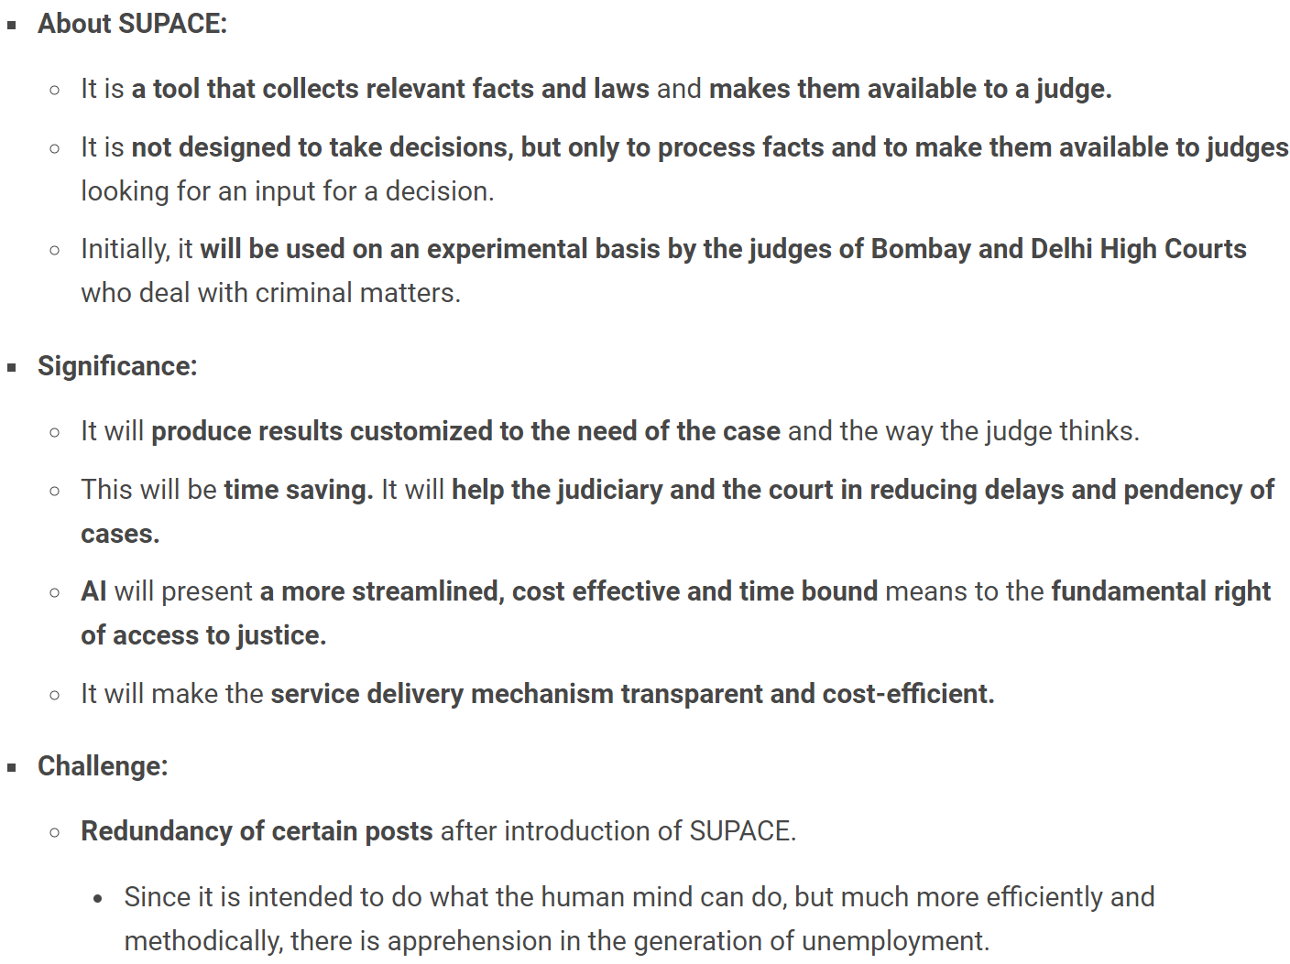
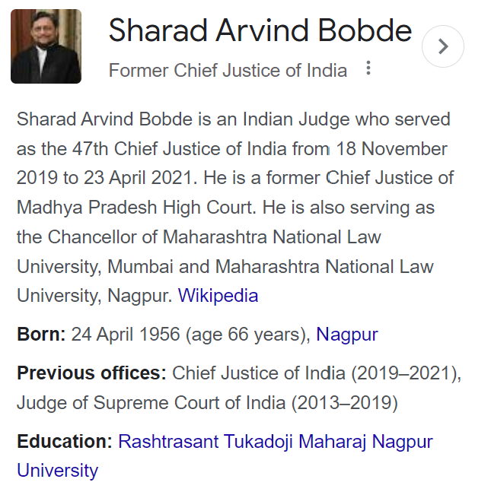
Revolution of Legal Industry in India (SUPACE)
Earlier this year, Chief Justice of India SA Bobde, in no uncertain terms, underlined that the Indian judiciary must equip itself with incorporating artificial intelligence in its system, especially in dealing with document management and cases of repetitive nature. With more industries and professional sectors embracing AI and data analytics, the legal industry, albeit in a limited way, is no exception.
Recently, the Chief Justice of India (CJI) launched an Artificial Intelligence (AI) based portal ‘SUPACE’ in the judicial system aimed at assisting judges with legal research.

Slide 34
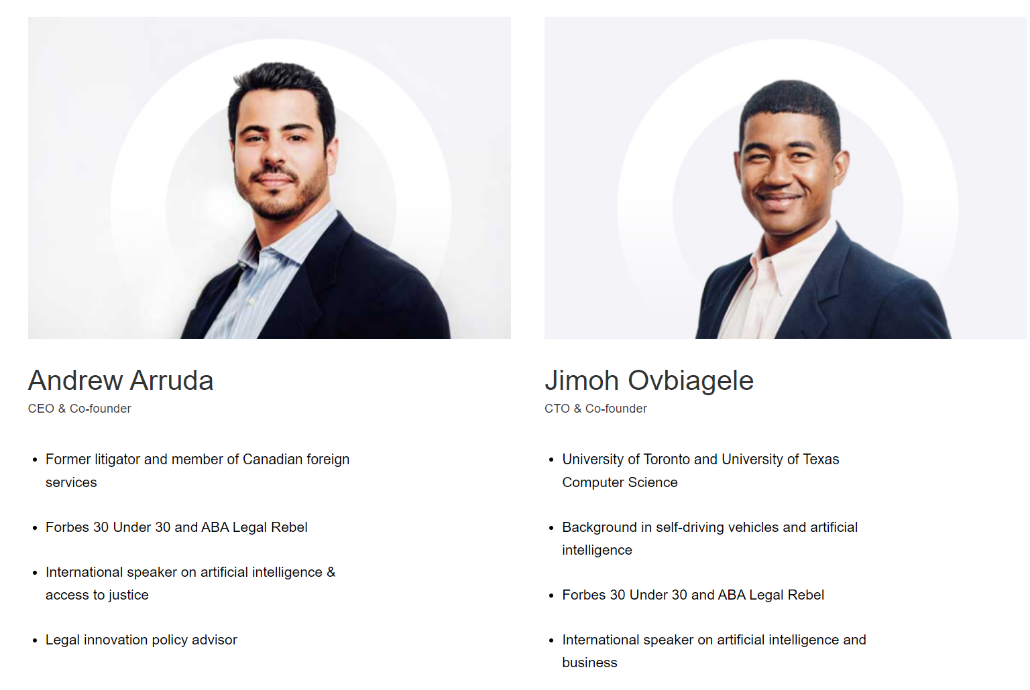
ROSS(Tool for Legal Reseach) and It’s Features
Given the efficiency and sorting speed of machines, several AI-based software is being used for reviewing documents to establish its relevance to a given case.
AI-assistant ROSS Intelligence, an online legal research tool built upon IBM’s Watson, has been helping lawyers in mining information from tonnes of legal paperwork through its cognitive computing and natural language processing capabilities.
Currently, ROSS Intelligence is being used across several law firms around the world, including some prominent names such as
USA-based Baker Hostetler, Salazar Jackson, and K&L Gates.
https://www.rossintelligence.com/what-is-ai
Question-based Search
Search less, answer more.
Save time by asking your legal question in language you would use with a colleague.
Find Similar Language
Leave no stone unturned.
Highlight text to find other cases with similar language to strengthen your position.
Document Analyzer
Ensure your arguments are bulletproof.
Check overturned and questioned treatments on any legal documents.
Question-focused Case Overviews
Get straight to the point.
Automatically summarize a case in the context of your query.
Case Treatments
Avoid bad law.
Quickly spot cases that have been overturned or criticized.

Slide 35


Indian Companies in the Legal Space
Gurugram-based LegalKart provides an AI-based app that connects clients with the best lawyers available in their vicinity. The clients also get real-time updates, information sharing and assistance. Reportedly India’s first practice management system for lawyers, LegalKart promises to revolutionise the way law professionals manage their practice. LegalKart’s clientele includes big names such as Ola and ZoomCars.
Bangalore-based SpotDraft is an AI-based contract management platform that helps customers draft, review, manage and sign contracts. This AI platform can also analyse legal documents and suggest users on clauses that can be negotiated on. The platform uses AI and ML for text analysis, which is conventionally used in academic work. Founded in 2017, SpotDraft has processed over 6,000,000 contracts as per the company website.

Slide 36

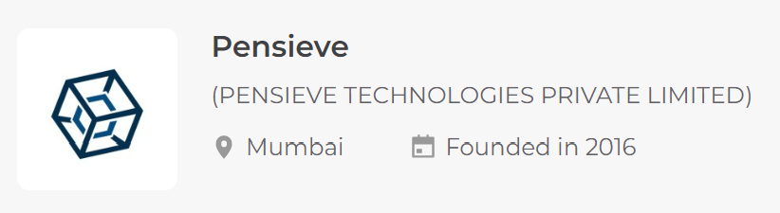
Indian Companies in the Legal Space
An NCR-based startup CaseMine is using AI to make legal research and analysis more in-depth and comprehensive as opposed to a regular search.
The CaseIQ software is a virtual research assistant provided by the company that obtains results from legal documents. The software helps in obtaining relevant search results without the need to reformulate case facts into searchable legal propositions.
Essentially a case law analytics system, CaseMine “enhances traditional legal research to move beyond mere keywords and retrieve relevant results using entire passages and briefs.”
Taking this concept from fiction to reality, Gaurav Shrivastava, Co-founder of Zimmber, built a startup for a transparent data machine - called Pensieve - with Co-founder Prahlad Routh. The two were ecstatic about implementing text analytics in the legal domain and the ample growth of Machine Learning (ML) and Artificial Intelligence (AI).

Slide 37
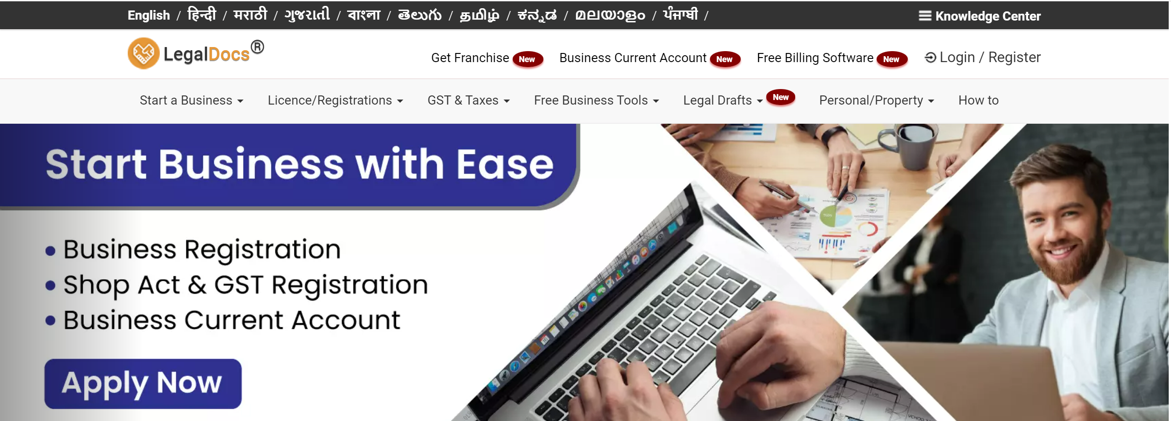
My Personal Favourite..! “LEGALDOCS”
“After getting married I had to go through mundane documentation like rent agreement registration, marriage registration, name change etc. It was a nightmare for me because there was a lack of information about how to get these documents and from where to get it,” Gaurav says about his struggle which prompted him to think differently.
Through LegalDocs, the three primary steps of legal documentation such as drafting, paying stamp duty and document validation can more or less be outsourced to Gaurav’s team.
All the customer needs to do is to go online and opt for the service that they need.
LegalDocs will enable the customers to avail verified legal documents at a predetermined rate, thus solving the problem of discovery and right pricing.
AI is also leveraged to draft regular legal documents like employee agreements, vendor agreements, non-disclosure agreements and cheque bounce, thus democratising the processes along the way.

Slide 38
IIT Kharagpur's AI System Automates Reading Of Legal Documents To Save Time
"Taking 50 judgments from the Supreme Court of India, we segmented these by first labelling sentences with the help of three senior law students from IIT Kharagpur's Rajiv Gandhi School of Intellectual Property Law, then performing extensive analysis of the human-assigned labels and developing a high quality gold standard corpus to train the machine to carry out the task," explained research lead Professor Saptarshi Ghosh.
This method can help in several downstream tasks such as summarizing of legal judgment, legal search, case law analysis, and other functions.
The researchers have developed two deep neural models to understand the rhetorical roles of sentences in a legal case judgment
A paper published on this research won the prestigious 'Best Paper Award' at JURIX 2019, the International Conference on Legal Knowledge and Information Systems, at Madrid.
The project is being supported by the Science &amp; Engineering Research Board (SERB) of the Department of Science and Technology, Government of India, under the project, 'NYAYA: A Legal Assistance System for Legal Experts and the Common Man in India'.
Ghosh's research scholar Paheli Bhattacharya is using network and text analysis to understand if two legal documents are similar. Among the other researchers are Kripabandhu Ghosh from the Tata Research Development and Design Centre, Pune, and Dr. Adam Wyner from Swansea University, UK. Shounak Paul is another research scholar associated with the project

Slide 39
To conclude..
Learning Data Science/Data Analytics can definitely help you building the bright future..!

Slide 40
Course PROGRESS
Lesson 2. Applications of Data Science
Lesson 4. Understanding the Technology Stack
Lesson 5. Hands on..!
Lesson 1. Data Science/Data Analytics
Lesson 3. Data Science for LAW

Slide 41
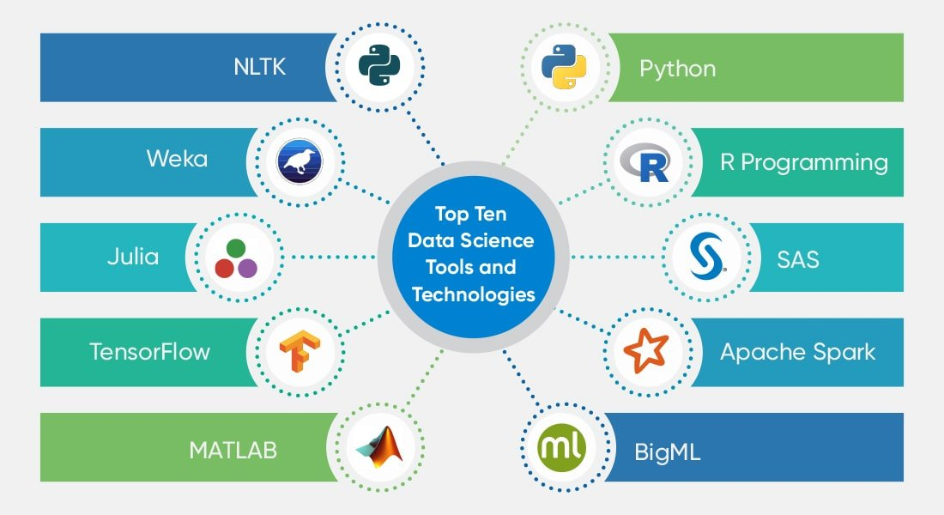
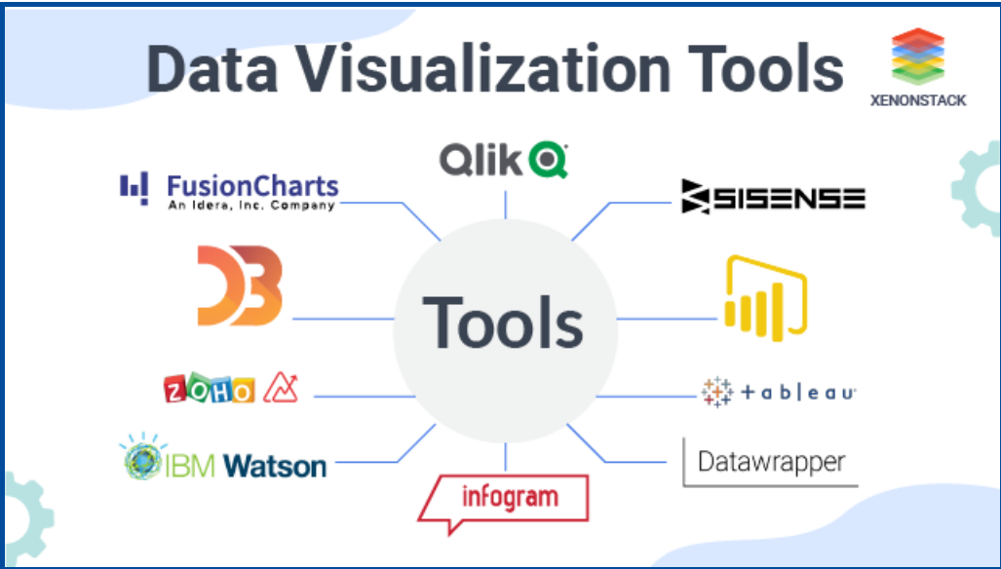
Data Science – Technology Stack
Data Analytics – Tools and Software
Data Visualization – Tools and Software

Slide 42
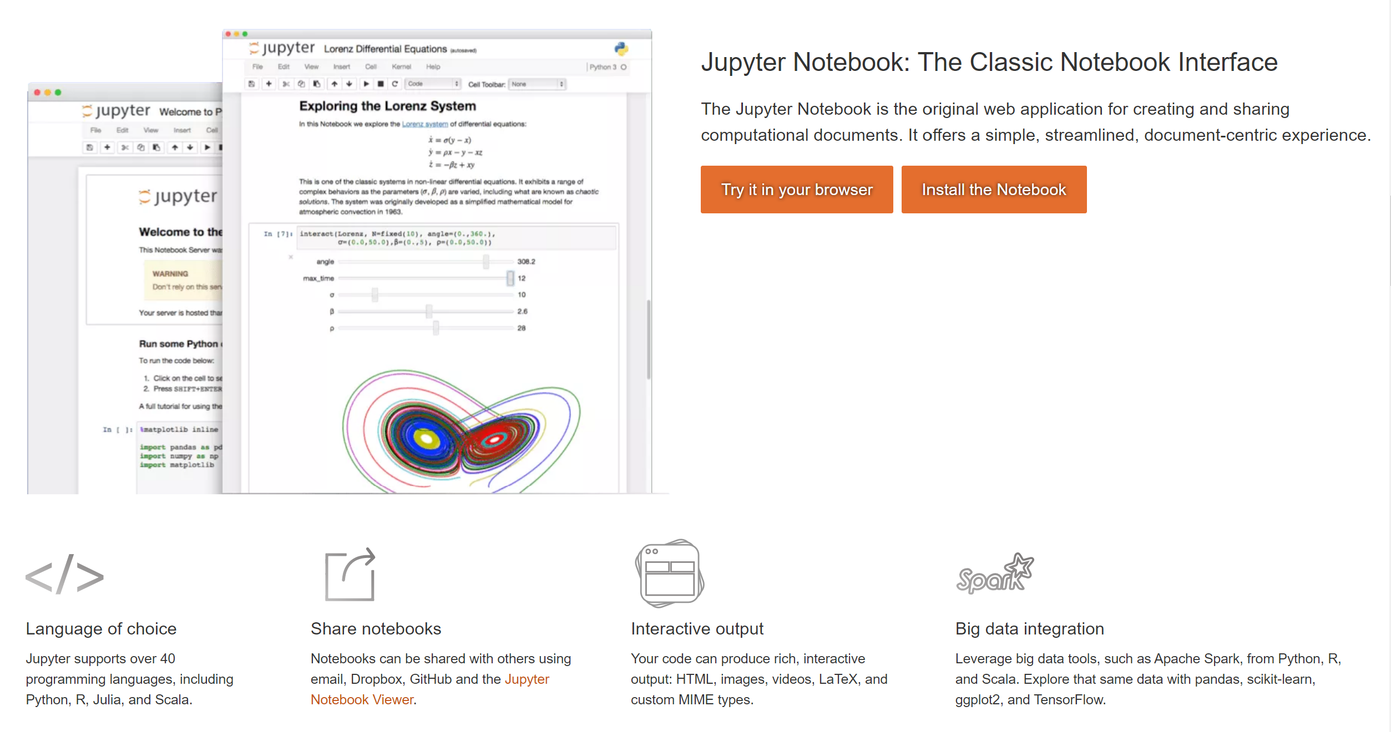
Popular IDE (Integrated Development Environment)

Slide 43
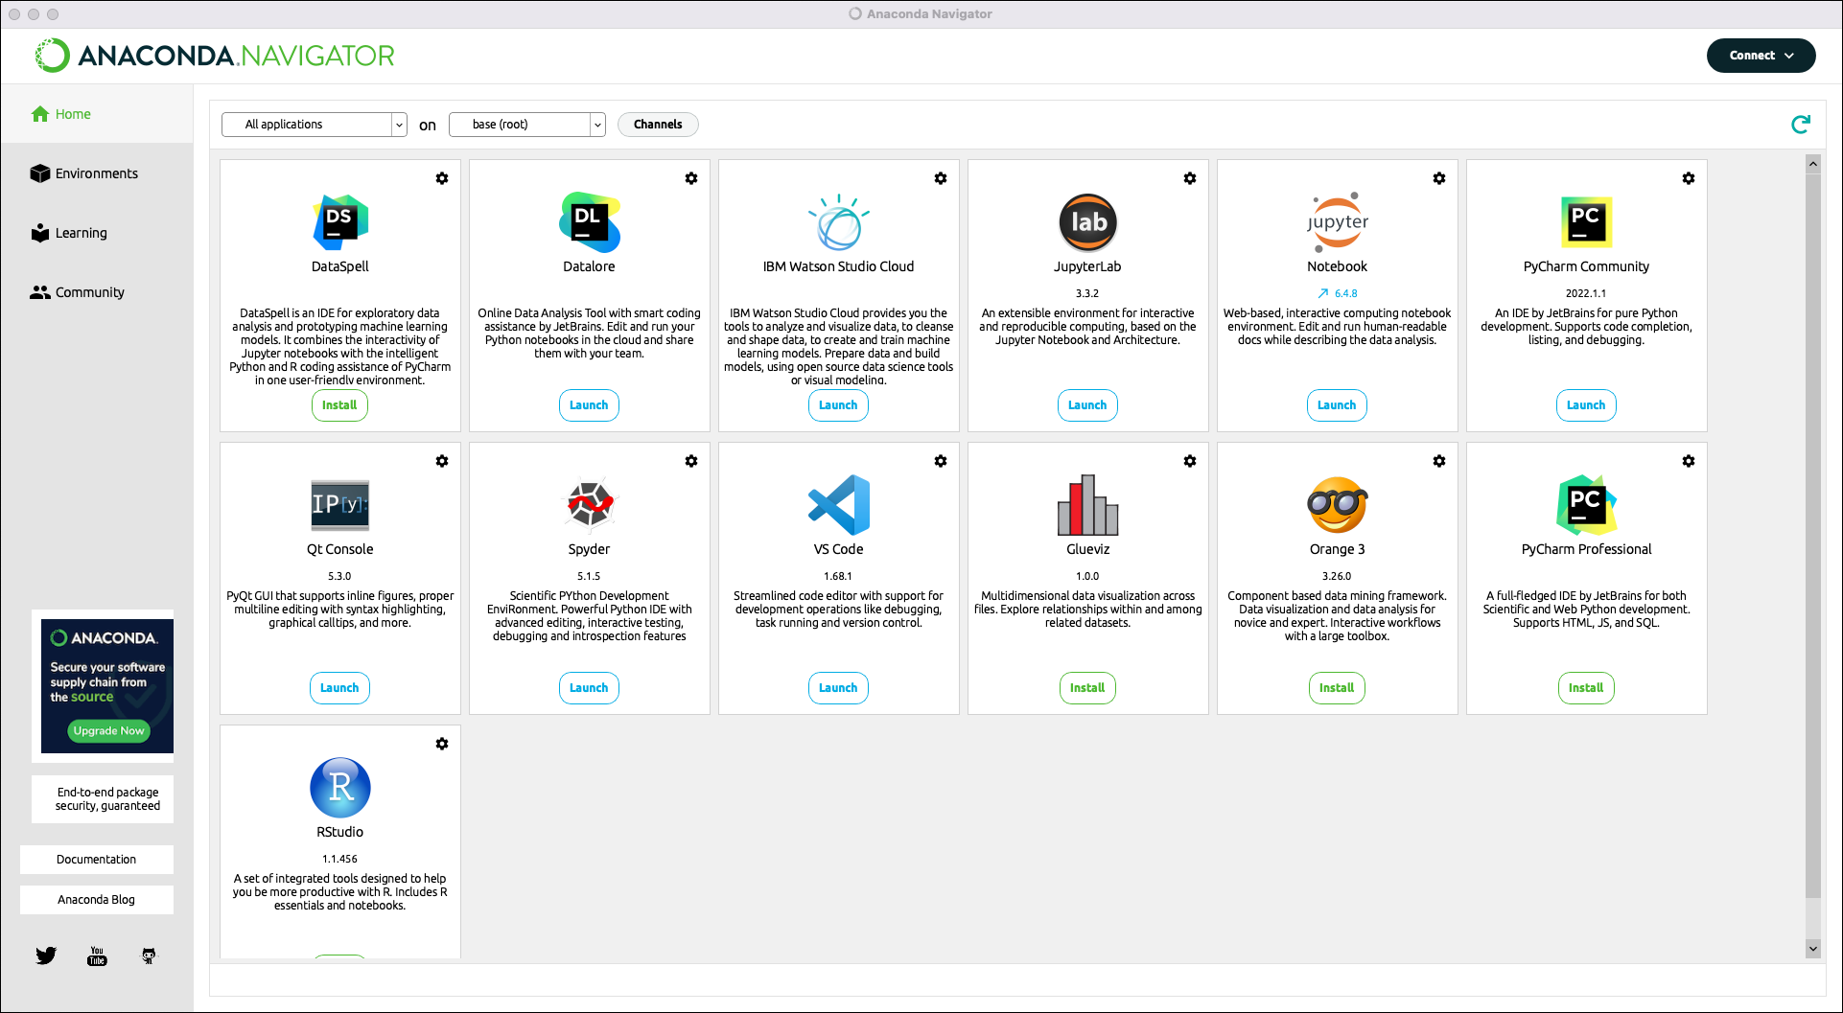
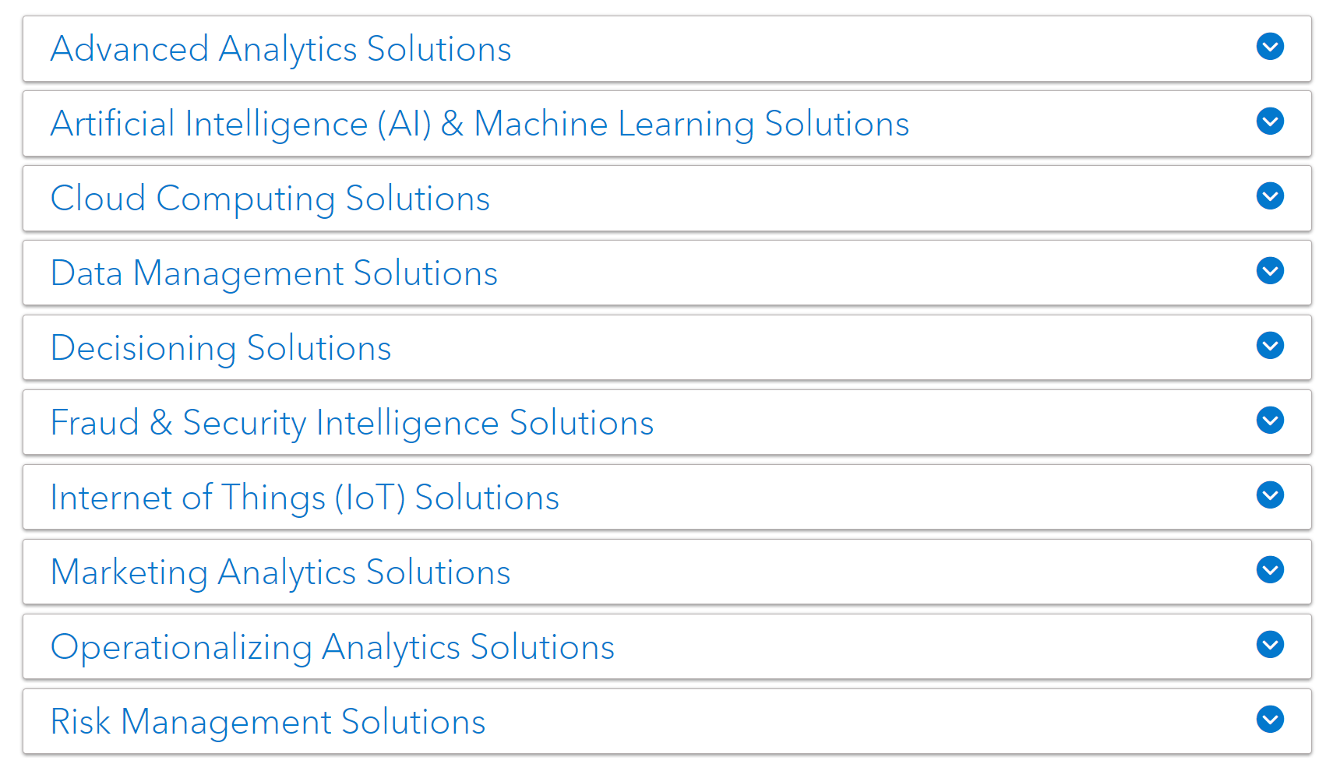
Popular IDE (Integrated Development Environment)

Slide 44
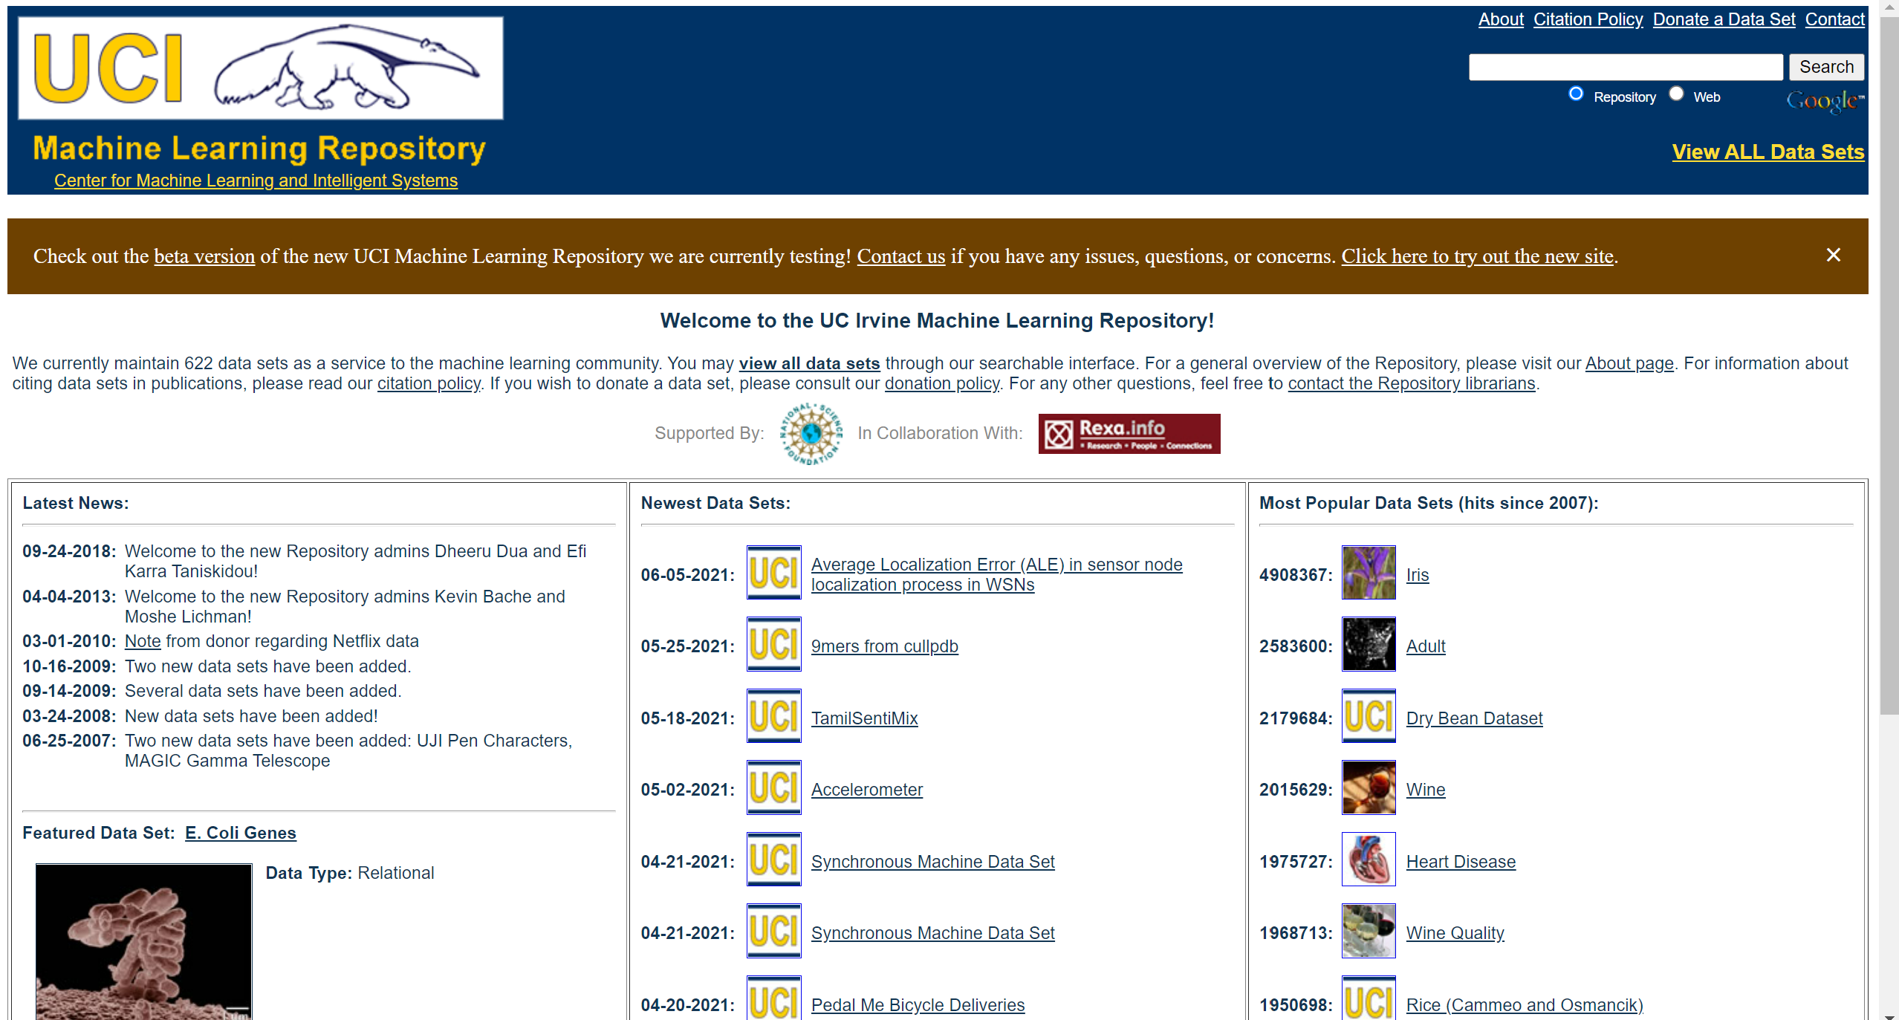
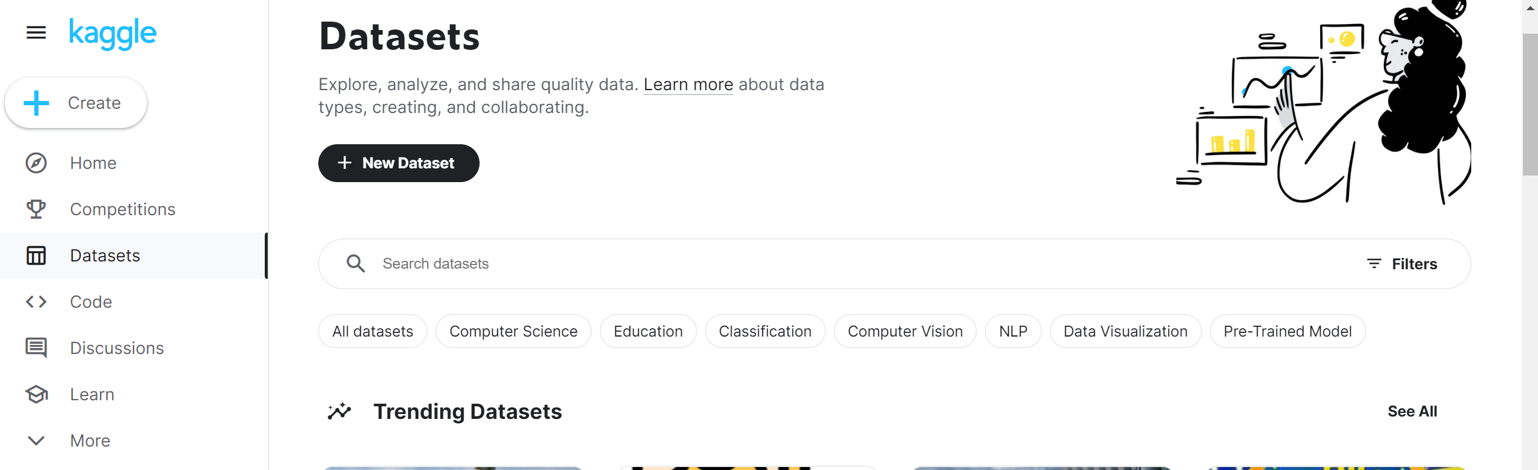
Open Datasets available..
My personal Favourite
https://archive.ics.uci.edu/ml/index.php
https://www.kaggle.com/datasets

Slide 45
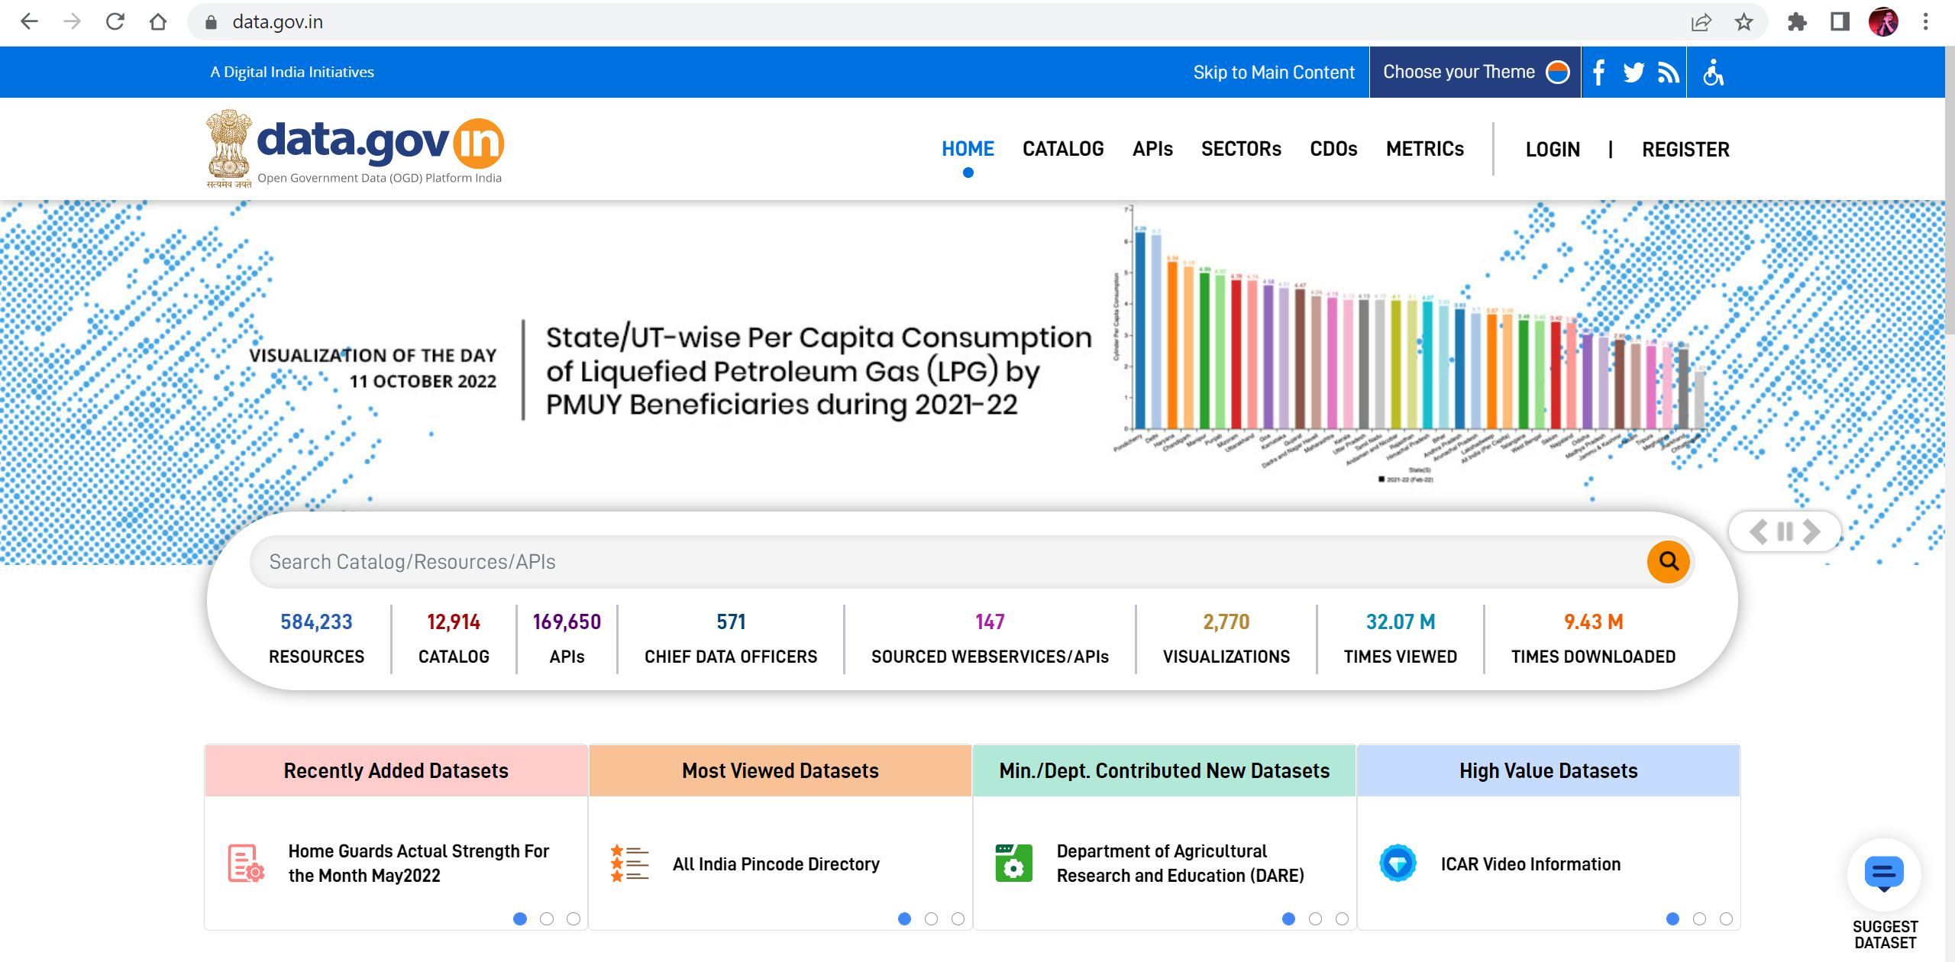
Indian Government Data Source for analysis

Slide 46
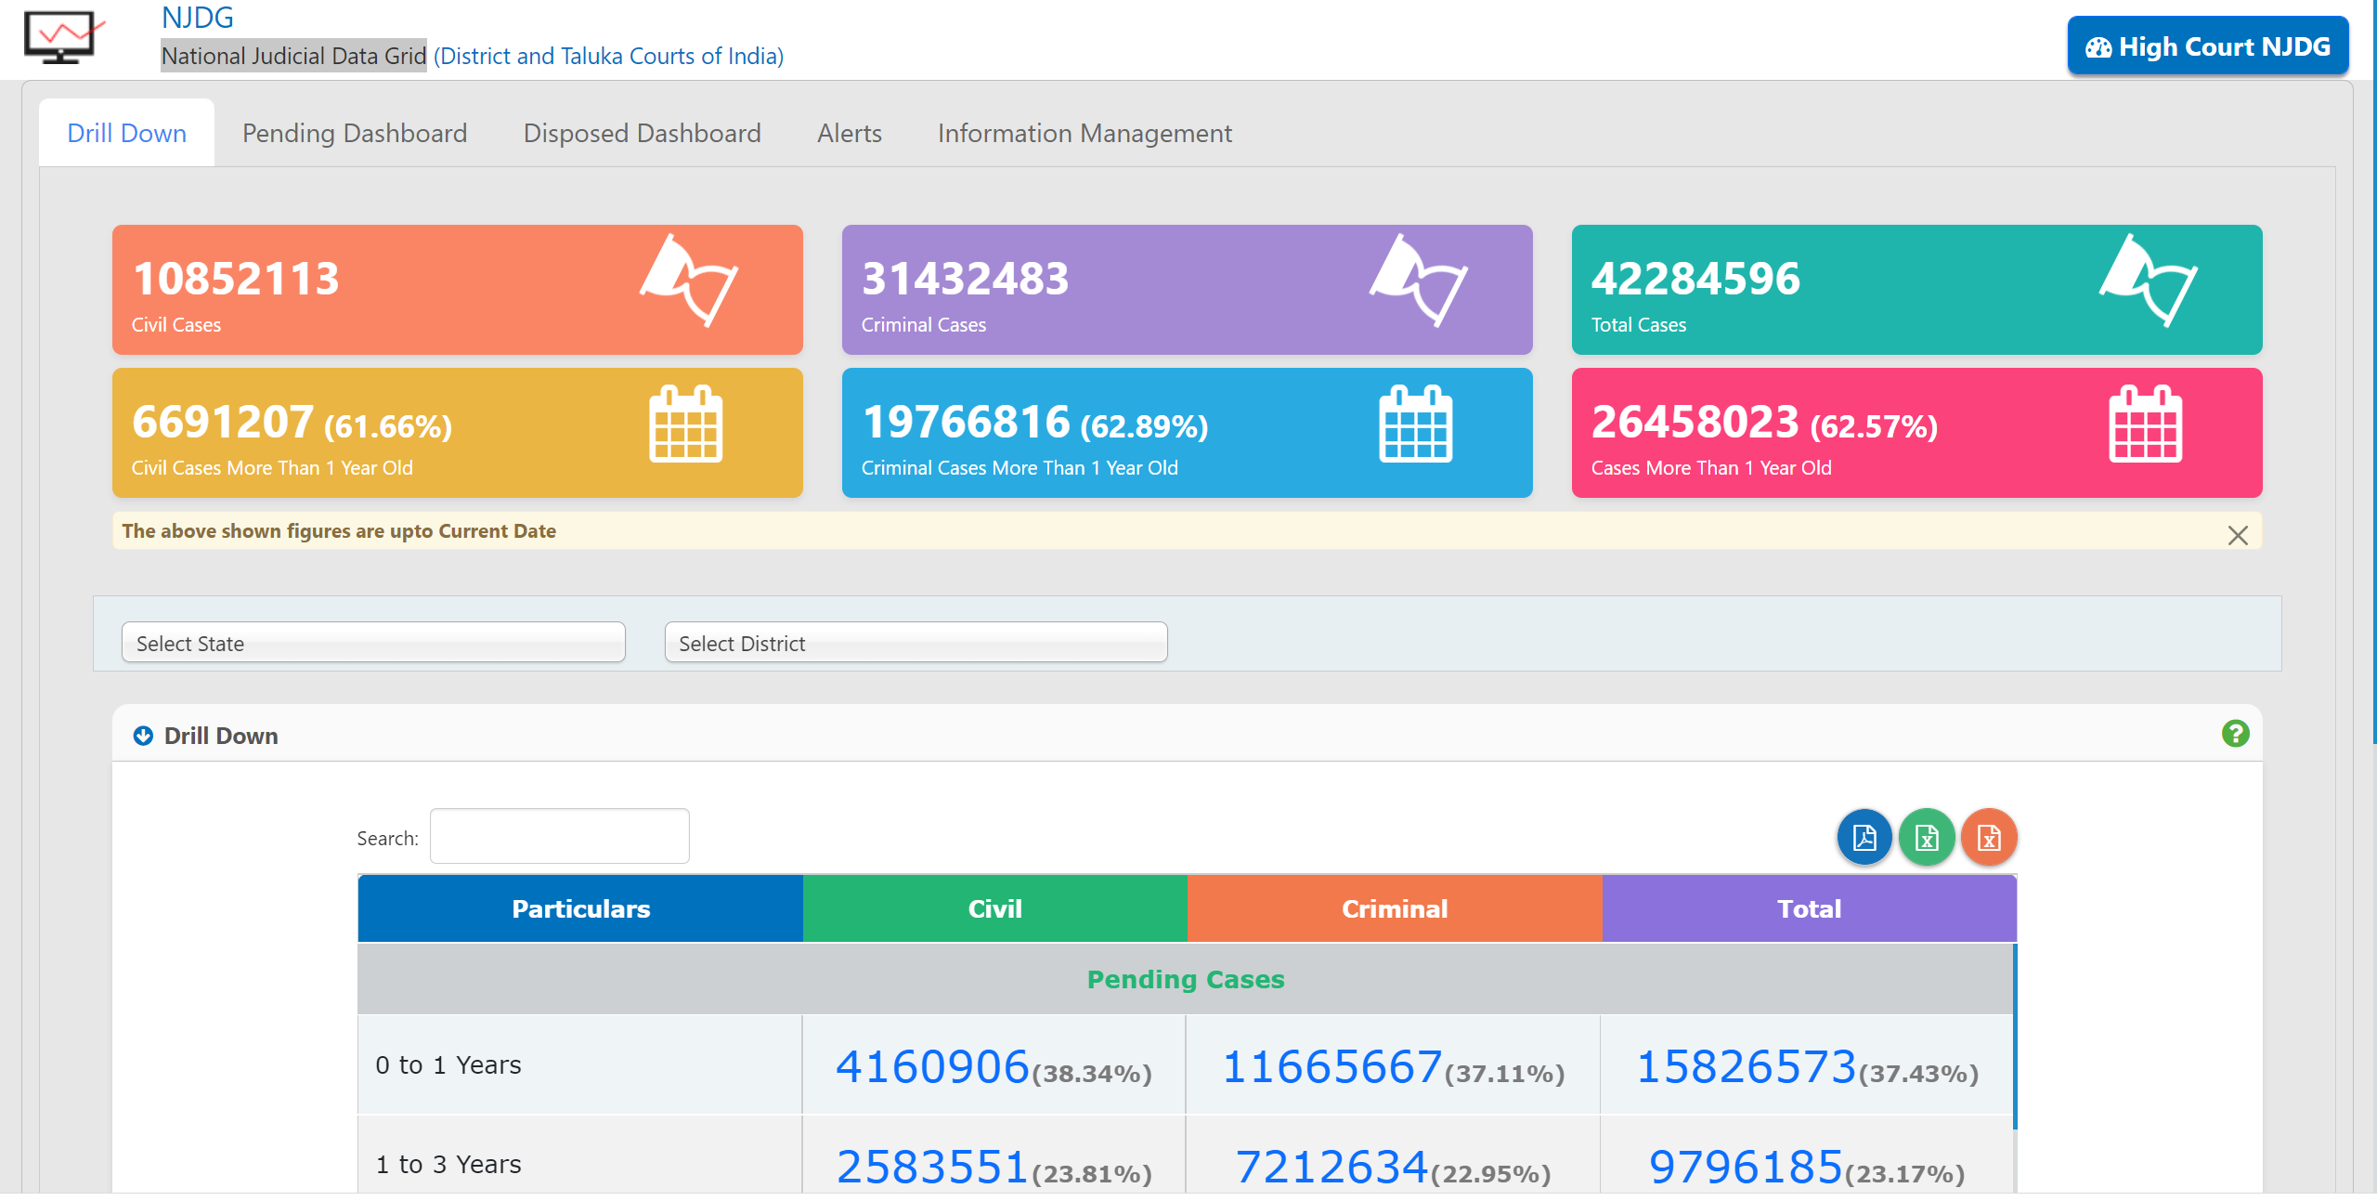
NJDG (National Judicial Data Grid)

Slide 47
Other Open Datasets
Other Open Datasets !
https://archive.ics.uci.edu/ml/index.php
https://www.kaggle.com/datasets
https://data.worldbank.org/
https://www.who.int/data/gho/
https://www.google.com/publicdata/directory
https://registry.opendata.aws/
http://open-data.europa.eu/en/data/
https://data.fivethirtyeight.com/
https://www.census.gov/
https://data.gov/
https://www.dbpedia.org/
https://github.com/freeCodeCamp/open-data
https://www.yelp.com/dataset
https://data.unicef.org/
https://www.ulb.uni-muenster.de/bibliothek/aktivitaeten/projekte/projekt-life.html
Blogs and platform to learn data science easily and effectively
(Personal recommendation)
https://www.analyticsvidhya.com/
https://www.kaggle.com/
https://ineuron.ai/
https://analyticsindiamag.com/

Slide 48
Course PROGRESS
Lesson 2. Applications of Data Science
Lesson 4. Understanding the Technology Stack
Lesson 5. Hands on..!
Lesson 1. Data Science/Data Analytics
Lesson 3. Data Science for LAW

Slide 49
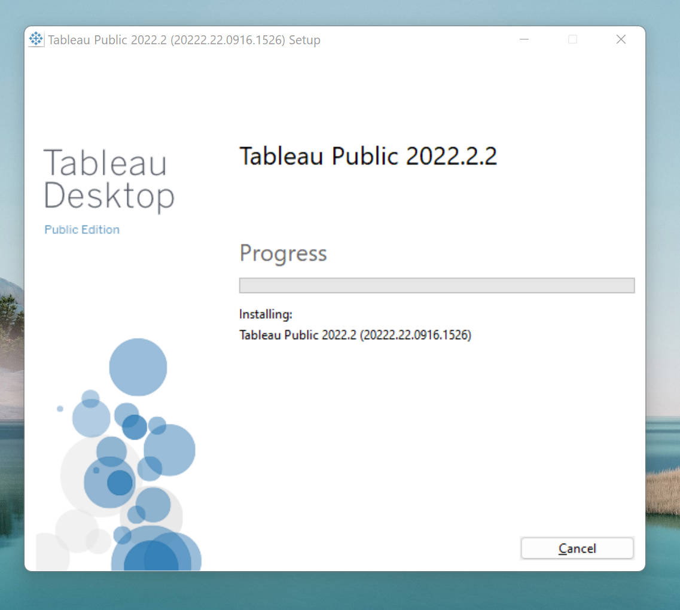
Download data set of the choice and try to Analyze
Dataset
https://public.tableau.com/app/resources/sample-data
Analysis – (Super Store Dataset)
https://help.tableau.com/current/guides/get-started-tutorial/en-us/get-started-tutorial-home.htm
One more Case study using Tableau
https://www.tableau.com/leading-through-change/tableau-dashboards

Slide 50
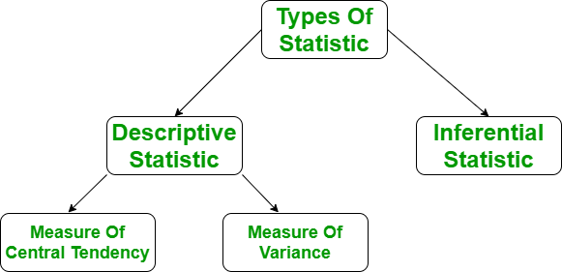
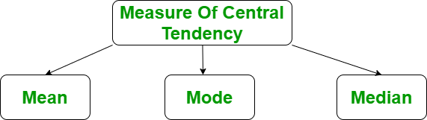
Basic Statistics Hands on
Measure of central tendency
The measure of central tendency is a single value that attempts to describe the whole set of data. There are three main features of central tendency –
Mean
Median
Median Low
Median High
Mode

Slide 51
MEAN
Mean
It is the sum of observations divided by the total number of observations. It is also defined as average which is the sum divided by count.
Mean= Sum(Xi)/N
The mean() function returns the mean or average of the data passed in its arguments. If passed argument is empty, StatisticsError is raised.
# Python code to demonstrate the working of
# mean()
# importing statistics to handle statistical
# operations
import statistics
# initializing list
li = [1, 2, 3, 3, 2, 2, 2, 1]
# using mean() to calculate average of list
# elements
print ("The average of list values is : ",end="")
print (statistics.mean(li))

Slide 52
Median
# importing the statistics module
from statistics import median
# Importing fractions module as fr
from fractions import Fraction as fr
# tuple of positive integer numbers
data1 = (2, 3, 4, 5, 7, 9, 11)
# tuple of floating point values
data2 = (2.4, 5.1, 6.7, 8.9)
# tuple of fractional numbers
data3 = (fr(1, 2), fr(44, 12),
fr(10, 3), fr(2, 3))
# tuple of a set of negative integers
data4 = (-5, -1, -12, -19, -3)
# tuple of set of positive
# and negative integers
data5 = (-1, -2, -3, -4, 4, 3, 2, 1)
# Printing the median of above datasets
print("Median of data-set 1 is % s" % (median(data1)))
print("Median of data-set 2 is % s" % (median(data2)))
print("Median of data-set 3 is % s" % (median(data3)))
print("Median of data-set 4 is % s" % (median(data4)))
print("Median of data-set 5 is % s" % (median(data5)))
Median
It is the middle value of the data set. It splits the data into two halves. If the number of elements in the data set is odd then the center element is median and if it is even then the median would be the average of two central elements.
For Odd Numbers:
(n+1)/2
For Even Numbers:
(n/2) or (n/2+1)
median() function is used to calculate the median, i.e middle element of data. If the passed argument is empty, StatisticsError is raised.

Slide 53
Mode
Mode
It is the value that has the highest frequency in the given data set. The data set may have no mode if the frequency of all data points is the same. Also, we can have more than one mode if we encounter two or more data points having the same frequency.
mode() function returns the number with the maximum number of occurrences.
If the passed argument is empty, StatisticsError is raised.
# Importing the statistics module
from statistics import mode
# Importing fractions module as fr
# Enables to calculate harmonic_mean of a
# set in Fraction
from fractions import Fraction as fr
# tuple of positive integer numbers
data1 = (2, 3, 3, 4, 5, 5, 5, 5, 6, 6, 6, 7)
# tuple of a set of floating point values
data2 = (2.4, 1.3, 1.3, 1.3, 2.4, 4.6)
# tuple of a set of fractional numbers
data3 = (fr(1, 2), fr(1, 2), fr(10, 3), fr(2, 3))
# tuple of a set of negative integers
data4 = (-1, -2, -2, -2, -7, -7, -9)
# tuple of strings
data5 = ("red", "blue", "black", "blue", "black", "black", "brown")
# Printing out the mode of the above data-sets
print("Mode of data set 1 is % s" % (mode(data1)))
print("Mode of data set 2 is % s" % (mode(data2)))
print("Mode of data set 3 is % s" % (mode(data3)))
print("Mode of data set 4 is % s" % (mode(data4)))
print("Mode of data set 5 is % s" % (mode(data5)))

Slide 54

References
https://lawecondata.ethz.ch/
https://analyticsindiamag.com/how-ai-data-analytics-is-impacting-indian-legal-system/
https://www.edexlive.com/news/2020/jul/28/the-future-of-law-in-india-why-94-believe-research-and-analytics-is-the-top-skill-a-lawyer-needs-13526.html
https://www.indiatoday.in/india/story/supreme-court-india-sc-ai-artificial-intellegence-portal-supace-launch-1788098-2021-04-07
https://learn.microsoft.com/en-us/azure/architecture/data-science-process/overview
https://www.intellspot.com/data-types/
https://community.tableau.com/
https://analyticsindiamag.com/
https://www.xenonstack.com/blog/top-data-visualization-tools
https://data-flair.training/blogs/data-science-tools/
https://towardsdatascience.com/data-visualization-in-data-science-5681cbdde5bf
https://www.knowledgehut.com/blog/data-science/what-is-data-science-life-cycle
https://www.wordstream.com/blog/ws/2017/07/28/machine-learning-applications
https://www.altexsoft.com/blog/engineering/ai-airlines/
https://intellipaat.com/blog/tutorial/data-science-tutorial/
https://www.spiceworks.com/it-security/vulnerability-management/articles/what-is-fraud-detection/
https://www.discoverdatascience.org/industries/logistics/
https://www.cambridgespark.com/case-studies/
https://www.geeksforgeeks.org/major-applications-of-data-science/

Slide 55
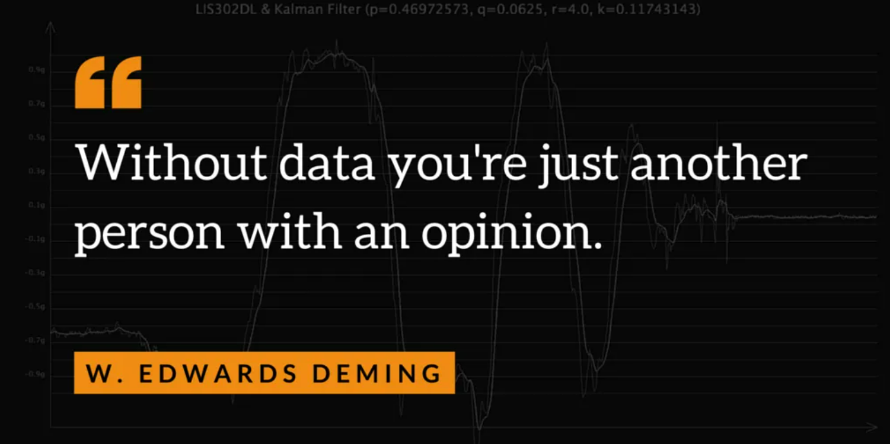
THANK YOU!
Disclaimer –
All the content presented in the presentation has been collated over the internet for the benefits of the students and all the related references has been added. Presented content has not been developed by the presenter.

